Slide 1
Santa Clara Valley Habitat Plan
Training for Consultants
February 19, 2014
Notes:
Ken

Slide 2
Overview and Goals of Presentation
Provide an overview of the Santa Clara Valley Habitat Plan, its benefits, and roles and responsibilities
Provide an overview of the compliance process and resources
Understand information required to evaluate a covered project

Slide 3
Part 1
Understanding the Santa Clara Valley Habitat Plan

Slide 4
Understanding the Santa Clara Valley Habitat Plan
Why a regional habitat plan?
What is the Santa Clara Valley Habitat Plan?
What are the benefits of the Habitat Plan?
What are the roles and responsibilities?

Slide 5
Key Terms
Take
Take Authorization (also called Endangered Species Permits)
Permit Term
Covered Projects
Covered Species
Please see handout for key terms defined.

Slide 6
Why a Regional Habitat Plan?
Endangered Species Permitting -- Business as Usual

Slide 7
Why a Regional Habitat Plan?
Link Endangered Species Permitting to City and County General Plans and regional infrastructure needs.
Plan for purchase and preservation of best habitat in region – Regional Reserve System
Contribute to species recovery

Slide 8
What is the Santa Clara Valley Habitat Plan?
The Habitat Plan is a 50-year regional plan to protect endangered species and other natural resources while allowing for orderly development.
The Habitat Plan resulted in endangered species permits from the CDFW and USFWS for 50 years.
The Habitat Plan is a regulatory document and is not voluntary.

Slide 9
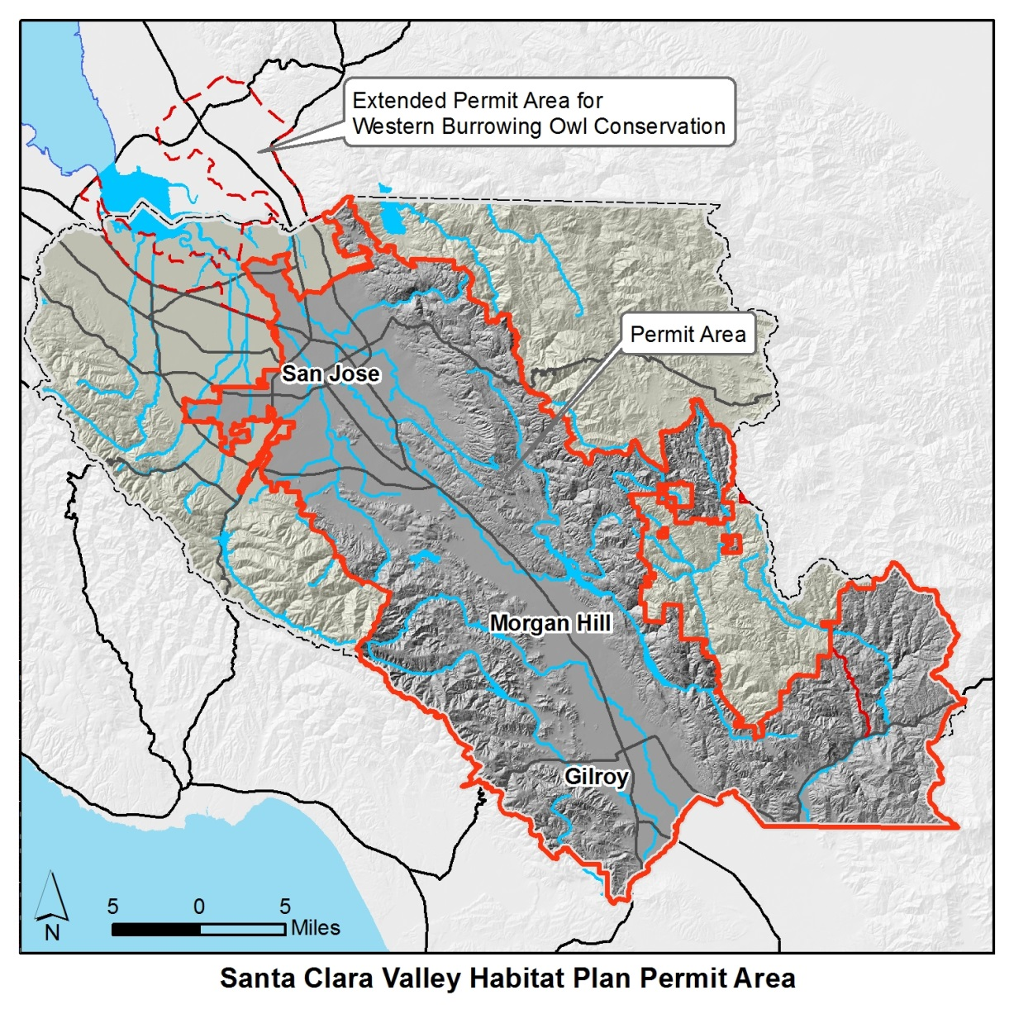
Permit Area
Approximately 508,700 acres
Permit Area Boundaries Defined by:
    All of City of San Jose except Baylands
    All of City of Morgan Hill and Gilroy
    Santa Clara County in Guadalupe, Coyote, and Pajaro Watersheds
    Excludes Henry Coe State Park
Notes:
Permit Area
Permit Term
50 year term based on
Time to implement covered activities
Time to implement conservation strategy
Time to secure adequate funding

Slide 10
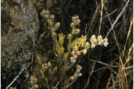
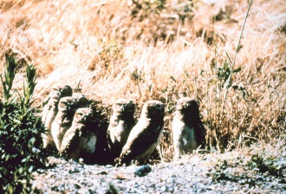
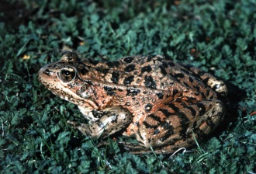
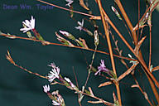
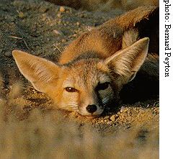
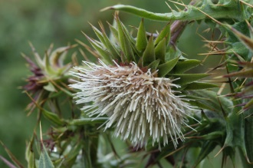
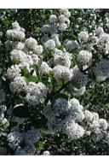
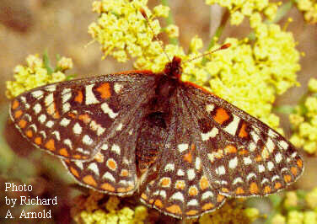
What is the Santa Clara Valley Habitat Plan?
Provides Conservation for 18 Covered Species
Wildlife | Plants
Invertebrates | Tiburon Indian paintbrush
Bay checkerspot butterfly | Coyote ceanothus
Amphibians and Reptiles | Mount Hamilton thistle
California tiger salamander | Santa Clara Valley dudleya
California red-legged frog | Fragrant fritillary
Foothill yellow-legged frog | Loma Prieta hoita
Western pond turtle | Smooth lessingia
Birds | Metcalf Canyon jewelflower
Western burrowing owl | Most beautiful jewelflower
Least Bell’s vireo
Tricolored blackbird
Mammals
San Joaquin kit fox
© 2003 Dean Wm. Taylor
Golden eagle
© 2005 Janell Hillman
= survey requirements
Notes:
18 Covered Species

Slide 11
What is the Santa Clara Valley Habitat Plan?
Covered Projects
Projects receive authorization to impact species
Comprehensive coverage for public & private projects
Six broad categories—consistent with co-Permittee General Plans and other local policies:
    Urban Development
    Rural Development
    New Public Infrastructure
    Public Operations, maintenance and capital projects and facilities
    Santa Clara Valley Water District (SCVWD) activities
    Habitat Plan Reserve System
Notes:
Projects are well-defined actions that occur once in a discrete location (e.g., building a house). By contrast, activities are actions that occur repeatedly in one or more locations (e.g., vegetation management along roads and streams). Together, these activities and projects are the covered activities for which endangered species permits from the Wildlife Agencies will be obtained. Covered activities under the Habitat Plan include all types of private development and public projects so long as certain criteria are met. These criteria are summarized in the Habitat Plan Coverage Screening Form

Slide 12
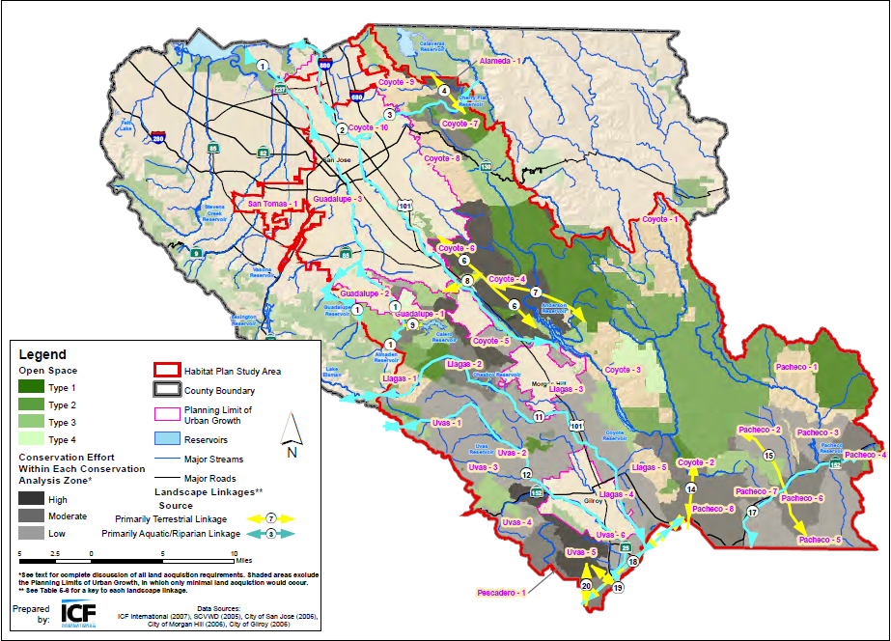
What is the Santa Clara Valley Habitat Plan?
Conservation Strategy
Protect up to 46,920 acres of open space and 100 miles of streams
Restore up to 428 acres of riparian woodlands and wetlands
Create up to 72 acres of ponds

Slide 13
Who Developed the Santa Clara Valley Habitat Plan?
The Plan was prepared by six local agencies.
City of Gilroy.
City of Morgan Hill.
City of San José.
County of Santa Clara.
Santa Clara Valley Water District.
Santa Clara Valley Transportation Authority.
Notes:
In developing the Habitat Plan, the Co-Permittees worked with the two agencies responsible for applicable state and federal laws pertaining to endangered species: the U.S. Fish and Wildlife Service (USFWS) and the California Department of Fish and Wildlife (CDFW). USFWS and CDFW are collectively referred to as the Wildlife Agencies.
The Habitat Plan is administered by the Habitat Agency, an entity governed by the Local Partners. Among the Habitat Agency’s duties are monitoring and reporting on the implementation of the Habitat Plan.
When was the Habitat Plan Developed?
Original Local Partners bound by MOU (June 2004)
Santa Clara County
City of San Jose
Santa Clara Valley Water District
Santa Clara Valley Transportation Authority
New Partners added in 2005
City of Gilroy
City of Morgan Hill

Slide 14
What are the Benefits of the Habitat Plan?
Local control. Allow local control of the extension of endangered species permits for local projects.
More efficient. Habitat Plan offers a more time efficient and simplified process to obtain endangered species authorization for private and public projects, including operations and maintenance activities.
Increased certainty. Provides private applicants and co-Permittees with greater certainty in mitigation requirements and timing.
Species recovery and land conservation. A regional approach to species recovery and land conservation

Slide 15
Permitting
What are the Benefits of the Habitat Plan?
Local Control and Increased Certainty for Project Permitting
USFWS
Endangered Species
CDFW
Endangered Species
U.S. Army Corps
(wetlands under 0.5 acres, stream under 300 linear feet)
Regional Board
Wetlands
(coming soon)
?
Business as Usual -Four permit stops
?
Santa Clara Valley Habitat Plan
Goal –
One permit stop
Notes:
Provide update on USACE permit
Includes NMFS BO

Slide 16
Who is Responsible for Overseeing the Habitat Plan?
The County and cities of Gilroy, Morgan Hill, and San Jose are responsible for Plan compliance for private development projects.
Each co-Permittee agency is responsible for ensuring its own public projects are carried out in conformance with the Plan.
The Santa Clara Valley Habitat Agency (Habitat Agency) is responsible for assembling the reserve system, reporting on progress of the Habitat Plan, and coordinating among the co-Permittees.
Notes:
The Santa Clara Valley Habitat Agency (Habitat Agency) is the agency primarily responsible for executing the requirements of the Habitat Plan, the federal and State endangered species permits, and the Implementing Agreement (the legal document between the Wildlife Agencies and co-Permittees to implement the Plan). The County and three cities are responsible for Plan compliance with respect to private development projects in their jurisdictions, and each co-Permittee is responsible for ensuring its own public projects are carried out in conformance with the Plan. The Habitat Agency will hold title to lands or easements it purchases and oversee cooperative agreements with land management entities that own and/or manage reserves as part of the Reserve System. The Habitat Agency may also provide funding to local land trusts and management agencies for them to purchase land for the Reserve System. The Habitat Agency will provide funds for reserve management and monitoring to those agencies and organizations with whom it contracts for such services.
The Habitat Agency is a joint powers authority (JPA) composed of the Cities of Gilroy, Morgan Hill, and San José, and the County. The JPA is limited to the four participating jurisdictions because the Joint Exercise of Powers Act requires that a JPA can only exercise powers held by all the participating agencies—and of the six participating agencies, only the four jurisdictions have the authority to adopt the Habitat Plan development fees. However, because all six agencies are responsible for implementing the Habitat Plan, each has a role in the Habitat Agency.

Slide 17
What are the Roles and Responsibilities of Local Agency Staff?
Confirm project is within Habitat Plan permit area and eligible to be covered by the Habitat Plan
Assist applicants and provide them with information regarding Habitat Plan requirements
Receive and review applications for completeness and compliance with Habitat Plan
Determine and collect fees
Transmit fees collected to Habitat Agency
Prepare application material for agency’s own projects

Slide 18
What are the Roles and Responsibilities of
Private Applicants?
Confirm that project is within Habitat Plan permit area and eligible to be covered under the Habitat Plan
Conduct required planning surveys, as necessary
Incorporate relevant conditions into project design
Complete and submit Habitat Plan application package
Pay fees
Conduct pre-construction monitoring and construction monitoring, as necessary

Slide 19
What are the Roles and Responsibilities of the Habitat Agency?
Provide general information to public through website
Provide technical assistance to co-Permittees in interpreting the requirements of the Habitat Plan
Update Habitat Plan fees each year
Evaluate special cases
Implement the conservation strategy for the Habitat Plan
Document Habitat Plan compliance and complete annual reporting to Wildlife Agencies

Slide 20
What are the Benefits of the Habitat Plan?
Minimization of Species Surveys and Uncertainty
Permitting Streamlining
Current Process |  | Habitat Plan Process
Species surveys needed to determine if species could occur onsite |  | Verify onsite habitat type - consistent with mapping
Need pre-construction surveys and fencing to avoid “take” during construction |  | Reduced survey requirements covered species No reptile or amphibian surveys Limited survey area for other covered species

Slide 21
What are the Benefits of the Habitat Plan?
CEQA Streamlining
Current Process |  | Habitat Plan Process
Individual species assessments can create a timeline of 2+ years |  | Covered species surveys can be completed within 1 year
Individual mitigation measures for impacts to species |  | Provides standardized mitigation measures for covered species that may also provide umbrella mitigation for other CEQA species
Off-site mitigation may be needed to meet less than significant finding. |  | With payment of Habitat Plan fees and implementation of Habitat Plan conditions, impacts would be less than significant
Notes:
Biology, Land use, and water quality

Slide 22
Off-Site Mitigation Streamlining
What are the Benefits of the Habitat Plan?
Local Control and Increased Certainty for Project Permitting
Current Process |  | Habitat Plan Process
Identify and receive approval on suitable site (greatest challenge) |  | Pay fee (or use in lieu credit)
Obtain 2nd set of permits for mitigation project
Construct mitigation project
Monitor and report for 5 to 10 years

Slide 23
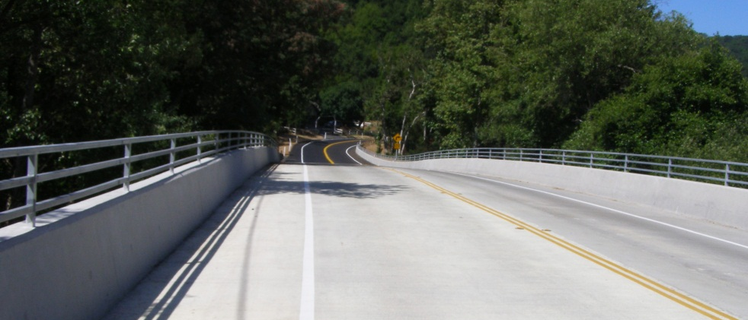
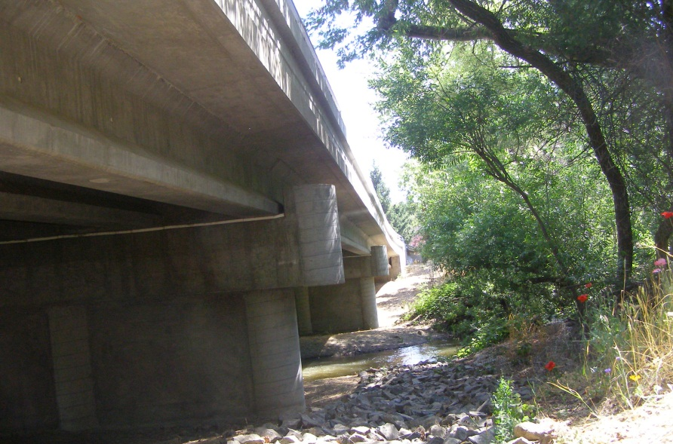
Uvas Bridge Project (37C-0093)
What are the Benefits of the Habitat Plan?
Project Example
Replaced 2-lane bridge
4 miles SW of Morgan Hill
Completed in 2009
Project cost:
$3.4 million
(not incl. off-site mitigation)

Slide 24
Uvas Bridge Process Comparison
What are the Benefits of the Habitat Plan?
Increased Certainty, Cost Effective, Species Recovery and Land Conservation
 | Current Process | Habitat Plan
Bridge Design & Construction Time | 5.5 years | 4 years
Off-Site Mitigation Costs | $485,000 (not incl. property cost) | $89,000 (incl. property cost)
Off-Site Mitigation Time | 4+ years since bridge completed, still working on site approval | 0 months
Notes:
Note that this is an extreme example but all bridge projects are facing increasingly difficult challenges in meeting off-site mitigation requirements.
If can’t resolve mitigation site issue, may be able to get permission to pay the $485K as a fee but only after the good faith, multi-year effort of trying to find an acceptable site.

Slide 25
Questions?

Slide 26
Part 2
Understanding the Process for Project Compliance with the Habitat Plan

Slide 27
Understanding the Process for Project Compliance with the Habitat Plan
Key Definitions
Overview of the process
Available resources

Slide 28
Key Terms
Covered Projects/Activities
Determination of Consistency
GIS
Land Cover
Natural Community
Permanent Impact
Permanently Disturbed Footprint
Proposed Development Area
Temporary Impact
Please see handout for key terms defined

Slide 29
Paradigm Shift
Covered vs. not covered. Not all species are covered and not all projects are covered, so it is important to find out if your species and project is covered. If you are working in the permit area, there is a good chance your project is covered
Covered vs. CEQA species. You can address the 18 covered species through the Habitat Plan, but may have to address additional species through the CEQA process (e.g., American badger, dusky-footed woodrat, golden eagle)
  Habitat Plan pre-determines species distribution and survey requirements for covered species
  No additional mitigation measures needed for Habitat Plan species and sensitive resources addressed

Slide 30
What is the Santa Clara Valley Habitat Plan?
Provides Conservation for 18 Covered Species
Wildlife | Plants
Invertebrates | Tiburon Indian paintbrush
Bay checkerspot butterfly | Coyote ceanothus
Amphibians and Reptiles | Mount Hamilton thistle
California tiger salamander | Santa Clara Valley dudleya
California red-legged frog | Fragrant fritillary
Foothill yellow-legged frog | Loma Prieta hoita
Western pond turtle | Smooth lessingia
Birds | Metcalf Canyon jewelflower
Western burrowing owl | Most beautiful jewelflower
Least Bell’s vireo
Tricolored blackbird
Mammals
San Joaquin kit fox
© 2003 Dean Wm. Taylor
Golden eagle
© 2005 Janell Hillman
= survey requirements
Notes:
18 Covered Species

Slide 31
Species Surveys
Species Surveys for these wildlife species: | Are required for projects located within: | Where one of the following land cover types is present:
Western burrowing owl | Occupied burrowing owl nesting habitat as defined by the Habitat Plan | N/A
Least Bell’s vireo | Least Bell’s vireo breeding habitat in South County | Riparian forest and scrub
Tricolored blackbird | Tricolored blackbird breeding habitat | Pond, coastal and valley freshwater marsh
San Joaquin kit fox | San Joaquin kit fox denning habitat | Any grassland, oak woodland, agricultural
Bay checkerspot butterfly | Serpentine bunchgrass grassland | Serpentine bunchgrass grassland

Slide 32
Species Surveys
Species | Requirements and Timeframe
 | Habitat Survey | Preconstruction Survey | AMMs | Construction Monitoring
 | Prior to submitting Habitat Plan Application Package | Within 2 calendar days of ground disturbance | Varies by species ª | During project construction
Western burrowing owl |  |  |  | 
Least Bell’s vireo |  |  |  | 
Tricolored blackbird |  |  |  | 
San Joaquin kit fox |  |  |  | 
Bay checkerspot butterfly |  |  | 
 Required.  May be required, as determined by results of the habitat survey and/or preconstruction survey. ª Specific-specific AMMs may be required during project design, construction, and/or operations and maintenance. For birds, some AMMs are breeding season–specific. See Habitat Plan, pages 6-62 to 6-73 for details.

Slide 33
Species Surveys
Surveys for these plants: | Are required for projects located within:
Smooth lessingia, fragrant fritillary, Metcalf canyon jewelflower, most beautiful jewelflower, Tiburon paintbrush, and Coyote ceanothus | Serpentine bunchgrass grassland or within 0.25 mile of a known occurrence
Santa Clara Valley dudleya, smooth lessingia, Metcalf canyon jewelflower, most beautiful jewelflower, and Tiburon paintbrush | Serpentine rock outcrop or within 0.25 mile of a known occurrence
Mount Hamilton thistle | Serpentine seep or within 0.25 mile of a known occurrence
Coyote ceanothus and most beautiful jewelflower | Mixed serpentine chaparral or within 0.25 mile of a known occurrence
Loma Prieta hoita | Mixed oak woodland and forest with serpentine soils or within 0.25 mile of a known occurrence
Loma Prieta hoita | Coast live oak forest and woodland with serpentine soils or within 0.25 mile of a known occurrence
Coyote ceanothus, Metcalf canyon jewelflower, most beautiful jewelflower, and smooth lessingia | Northern coastal scrub and Diablan sage scrub with serpentine soils or within 0.25 mile of a known occurrence

Slide 34
Mitigation Fees
Fee type | Fee rate
Land Cover Fees
Zone A | $15,416 per acre
Zone B | $10,688 per acre
Zone C | $3,905 per acre
Urban Areas | No fee
Specialty Fees
Burrowing owl | $50,438 per acre
Serpentine | $50,166 per acre
Riparian, wetlands, ponds | $139,708 - $255,182 per acre
Stream | $588 per linear foot
Other fees
Nitrogen deposition fee | $34 per residence or $3.60 per new daily vehicle trip

Slide 35
Overview of the Compliance Process
1
Determine if project is a covered activity
2
Conduct land cover mapping, wetland delineations, and species habitat surveys, as applicable
3
Incorporate relevant conditions into project design
4
a
Federal Agency consults with USFWS and/or NMFS
b
Determine if ESA Section 7 consultation is required
Biological Opinion issued by USFWS consistent with Habitat Plan requirements
Yes
No
5
Obtain Internal Approvals
6
Submit Habitat Plan Reporting Package to Habitat Agency
7
Pay Fees to Habitat Agency and/or conduct in lieu mitigation
8
9
10
12
Conduct preconstruction survey, if required
Apply AMMs, if required
Build Project
Conduct construction monitoring, if required

Slide 36
How does the Habitat Plan Fit into the CEQA Process?
Timeline
Planning
CEQA
Habitat Plan
1
7
8
12
Permitting
Design
Construction

Slide 37
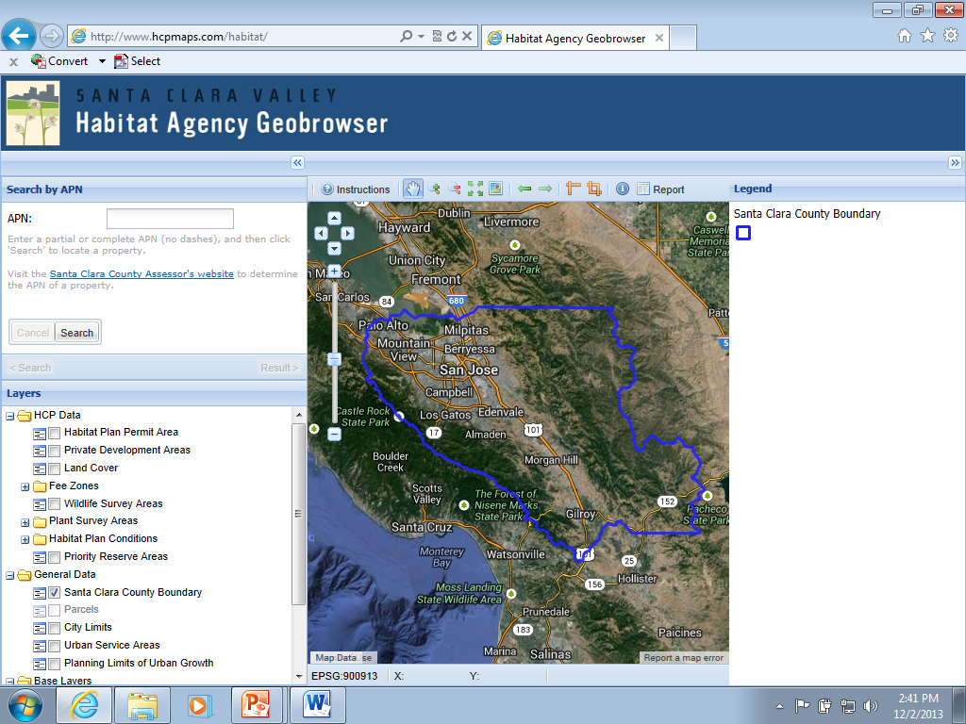
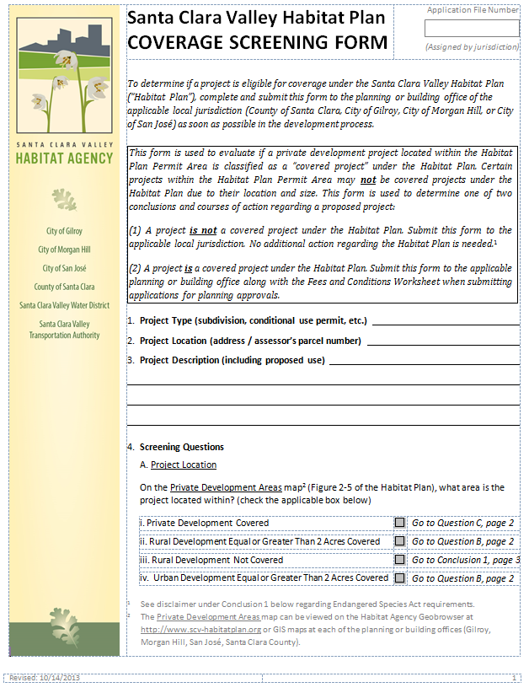
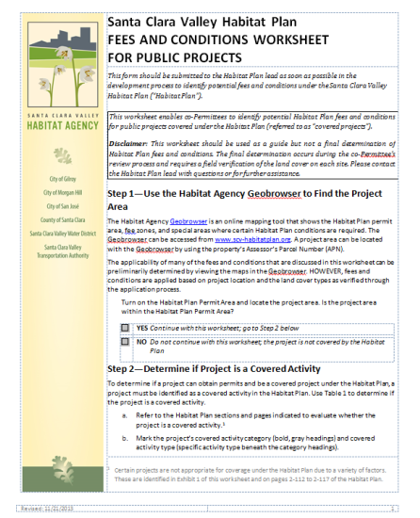
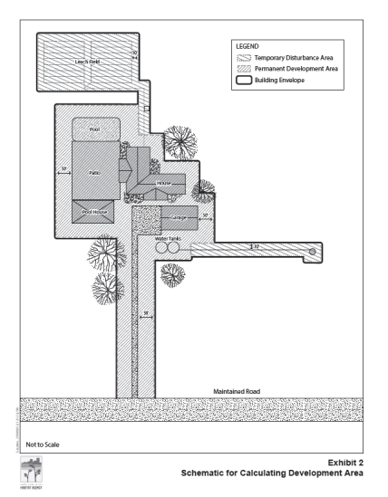
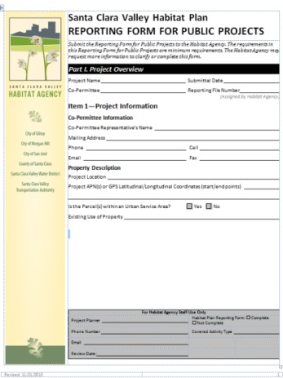
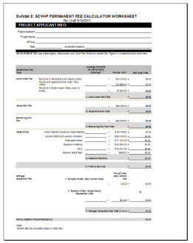
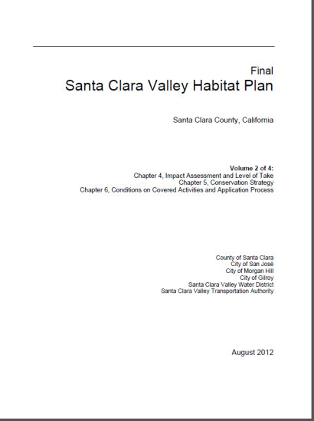
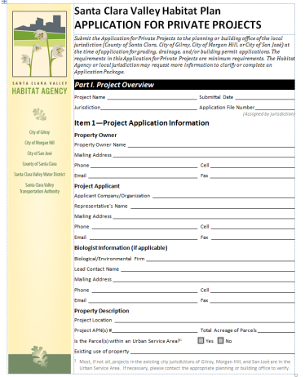
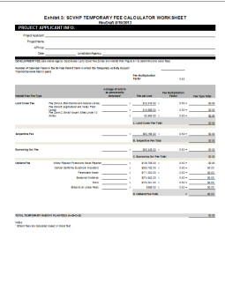
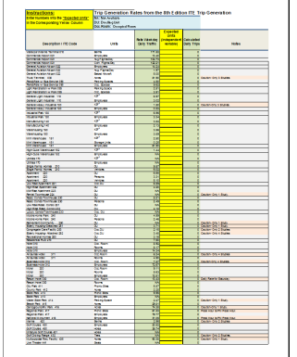
What Resources are Available?
Geobrowser
hcpmaps.com
Screening Form
Fees and Conditions Worksheet
Development Area Schematic
Application/ Reporting Form
Fee and Nitrogen Calculators
Santa Clara Valley Habitat Plan

Slide 38
Questions?

Slide 39
Part 3
Understanding Project Compliance Resources

Slide 40
Goals
Review Habitat Plan compliance resources
Understand how they fit into the compliance process
Provide an overview of the information required for the Habitat Plan application or reporting form

Slide 41
www.hcpmaps.com
Notes:
Terah – intro and APN

Slide 42
Overview of the Compliance Process
1
Determine if project is a covered activity
2
Conduct land cover mapping, wetland delineations, and species habitat surveys, as applicable
3
Incorporate relevant conditions into project design
4
a
Federal Agency consults with USFWS and/or NMFS
b
Determine if ESA Section 7 consultation is required
Biological Opinion issued by USFWS consistent with Habitat Plan requirements
Yes
No
5
Obtain Internal Approvals
6
Submit Habitat Plan Reporting Package to Habitat Agency
7
Pay Fees to Habitat Agency and/or conduct in lieu mitigation
8
9
10
12
Conduct preconstruction survey, if required
Apply AMMs, if required
Build Project
Conduct construction monitoring, if required

Slide 43
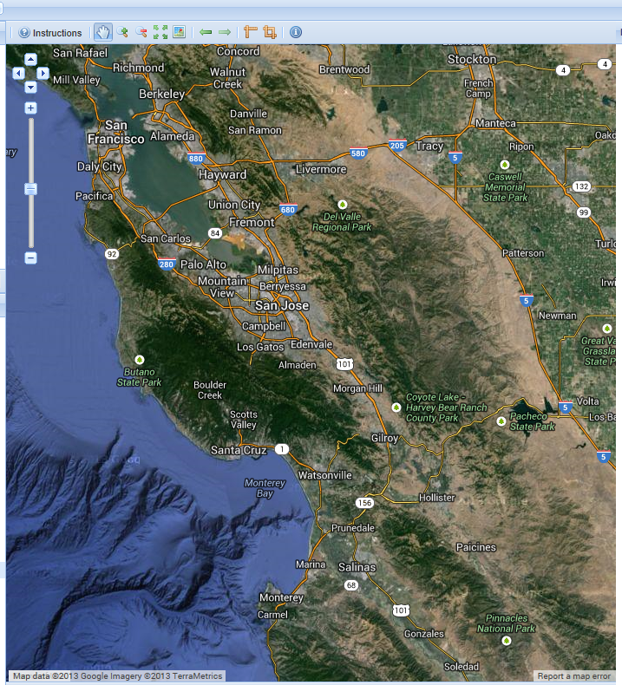
Confirm the Project is in the Habitat Plan Permit Area and Project is Covered by the Habitat Plan
In what zone is the project located within the Private Development Areas Map?
What is the total size of the project (in acres)?
Is the project site currently developed?
Does the project entail a building addition or new building within 50 feet of existing buildings where the total new impervious surface will be less than 5,000 square feet?
Will the project affect sensitive habitats?
Notes:
Greg
Screening form
Provide APN

Slide 44
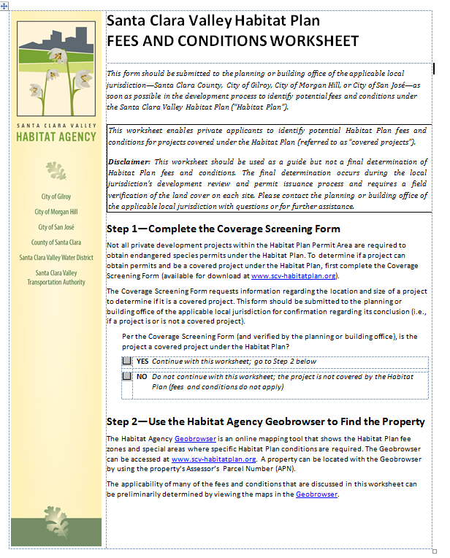
Determine Land Cover on Site and Estimate Fees / Conditions
Land Cover
How do I determine and document the land cover on the property?
Fees
How do I determine which Habitat Plan fees apply to a project?
How are the fees calculated?
Conditions
How do I determine which Habitat Plan conditions apply to a project?

Slide 45
Verify Land Cover on the Property
Land Cover | Field Verification Method
California Annual Grassland, Reservoir, Orchard, Vineyard, Grain, Row Crop, Hay and Pasture, Disked/Short-Term Fallowed, Agriculture Developed, Urban-Suburban, Rural-Residential, Golf Courses/Urban Parks, Landfill, Barren | Site Plans, Site Photos Planning or building office staff may also use aerial photos or a site visit for verification
Mixed Oak Woodland and Forest, Coast Live Oak Forest and Woodland, Mixed Evergreen Forest, Redwood Forest | Mapping by Arborist, Forester, or Qualified Biologist Requires site visit by arborist, forester, or qualified biologist and mapping of land covers
All other land covers not listed above, such as: Serpentine Bunchgrass Grassland, Northern Mixed Chaparral, Mixed Riparian Forest, Seasonal Wetland | Mapping by a Qualified Biologist Requires site visit by qualified biologist and mapping of land covers

Slide 46
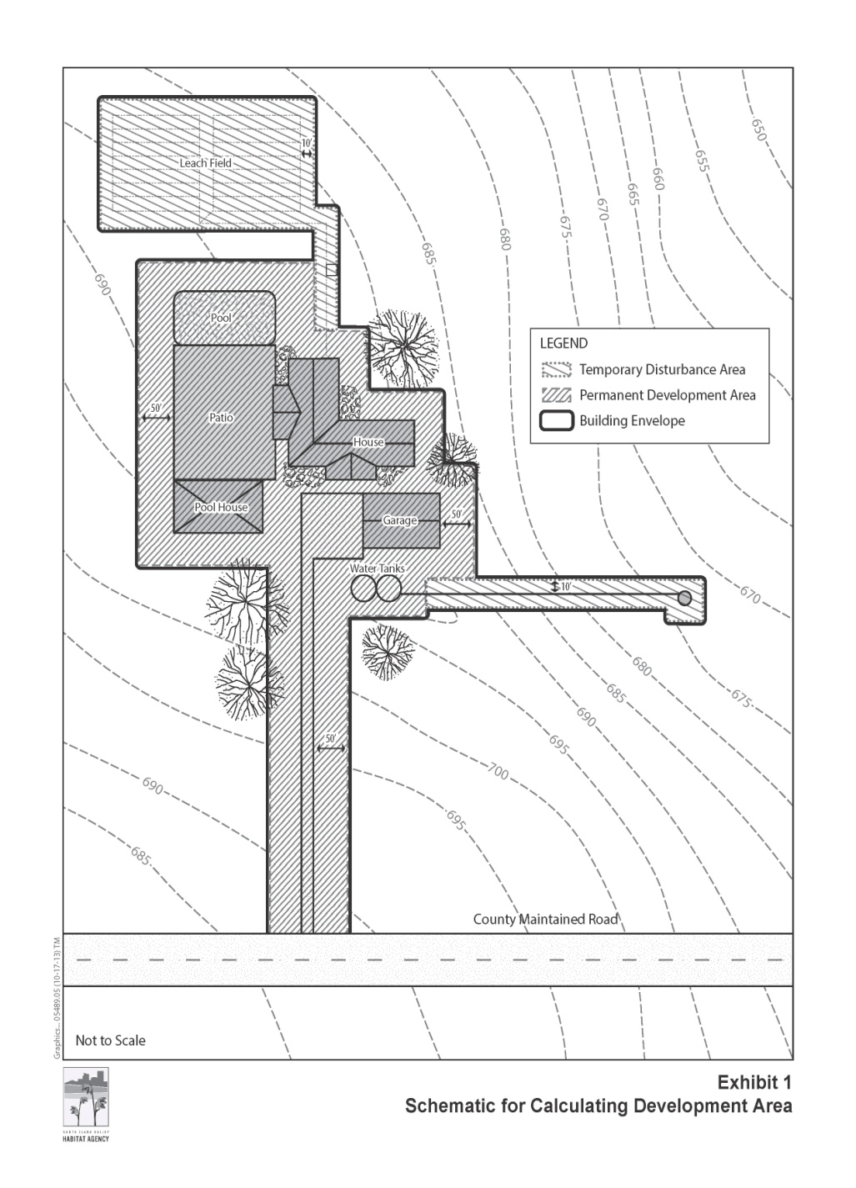
Proposed Development Area

Slide 47
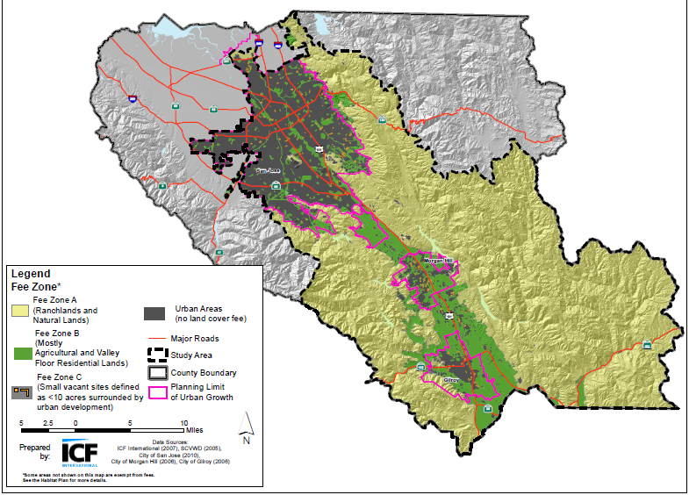
Habitat Plan Fees
Vehicle-trip or by New Single Family Residence
Nitrogen Deposition
Land Cover Fees
Zone A
Zone B
Zone C
Specialty Fees
Occupied Burrowing Owl habitat (mapped)
Serpentine
Wetlands
Notes:
Where is the project located?
What land cover will be impacted?
Will the project result in additional vehicle trips?

Slide 48
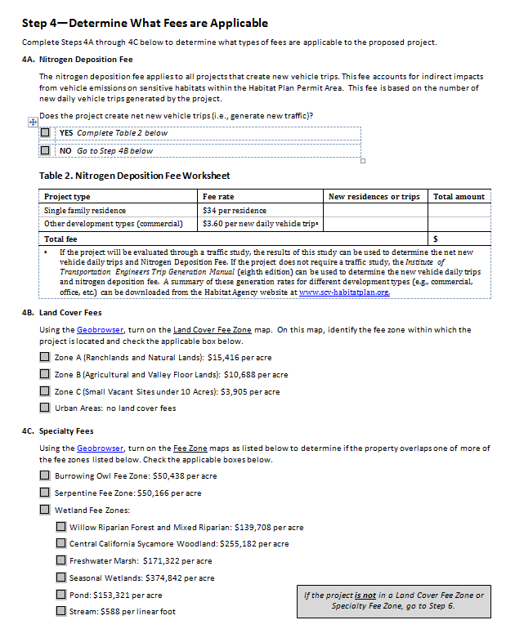
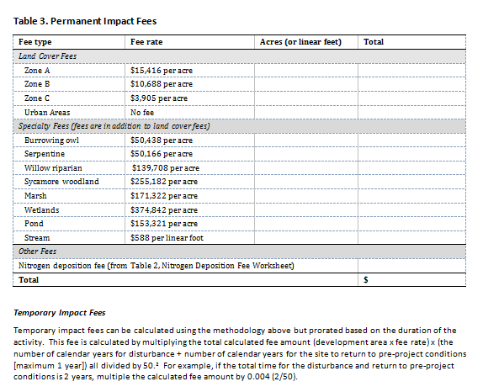
Habitat Plan Fees
Notes:
Where is the project located?
What land cover will be impacted?
Will the project result in additional vehicle trips?

Slide 49
Habitat Plan Conditions
All Covered Projects
Covered Project Categories
Natural Communities
Condition 1
Condition 3
Urban Development
Condition 2
In-Stream Projects
Condition 4
In-Stream O&M
Condition 5
Rural Transportation Projects
Condition 6
Rural Development Projects
Condition 7
Rural O&M
Condition 8
Reserve System Implementation
Condition 9
Condition 10
Stream and Riparian
Condition 11
Wetland and Pond
Condition 12
Serpentine
Condition 13
Valley and Blue Oak
Condition 14
Wildlife
Bay Checkerspot Butterfly
Condition 13
Western Burrowing Owl
Condition 15
Least Bell’s Vireo
Condition 16
Tricolored Blackbird
Condition 17
San Joaquin kit fox
Condition 18
Plants
Plant Salvage
Condition 19
Plant Avoidance and Minimization
Condition 20

Slide 50
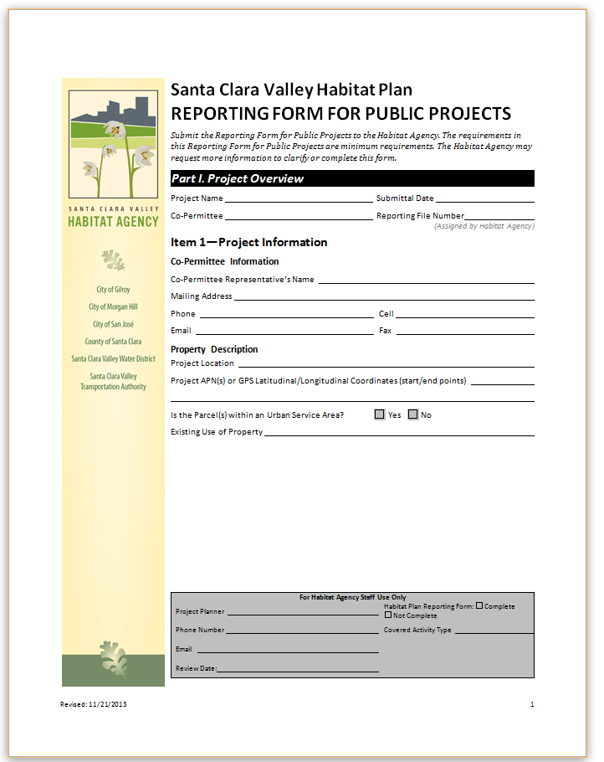
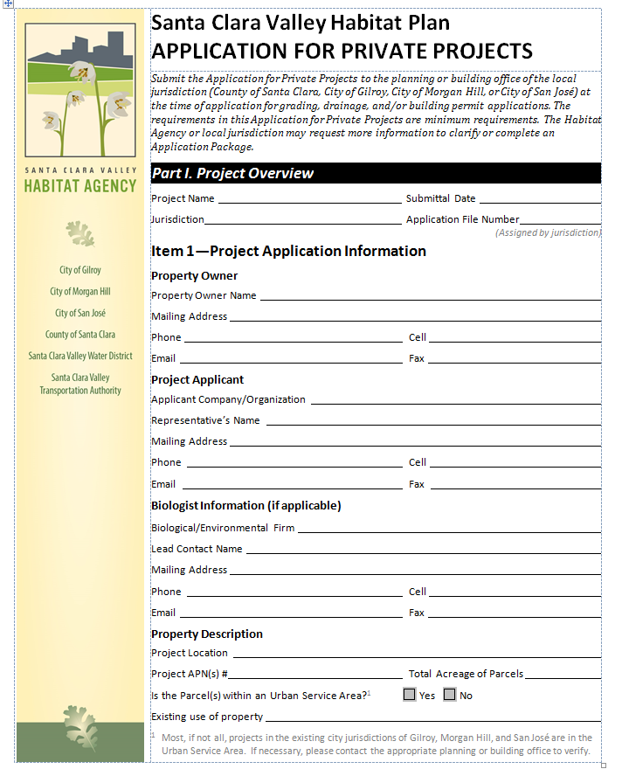
Habitat Plan Application/Reporting Package
Project Overview
Existing Conditions and Impacts
Species-Specific Preconstruction Surveys, Avoidance, and Monitoring Requirements.
Conditions
Fees

Slide 51
Project Overview
Project Name
Submittal date
Local jurisdiction
Application file number (assigned by planner)
Property Owner
Project Applicant
Biologist Information
Property Description
Development Area
Fee Zone

Slide 52
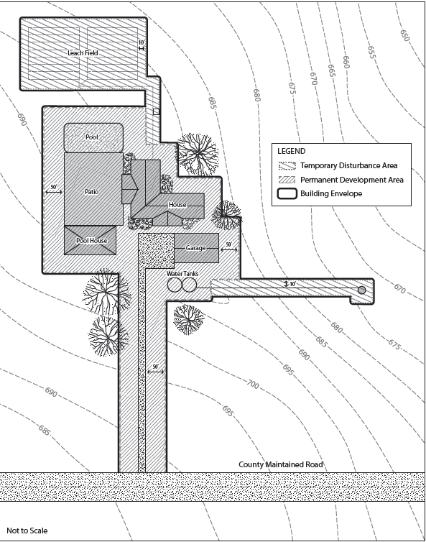
Project Overview
Item 2: Project Description
Project description.
Vicinity map.
Project Site Plan.
Temporary impact site photo documentation.
GIS- or Computer-Aided Design (CAD) compatible files of Vicinity Map and Project Site Plan.

Slide 53
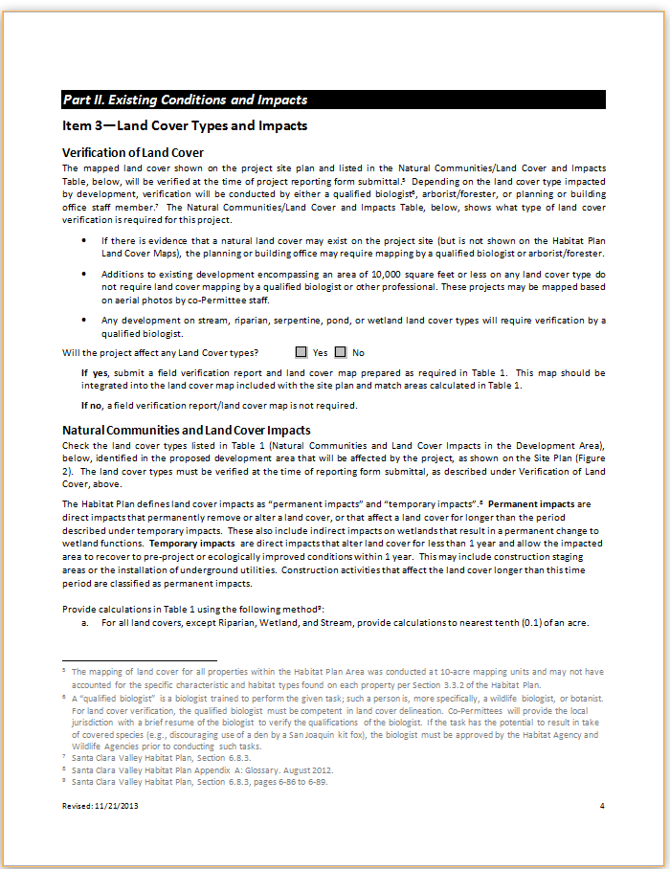
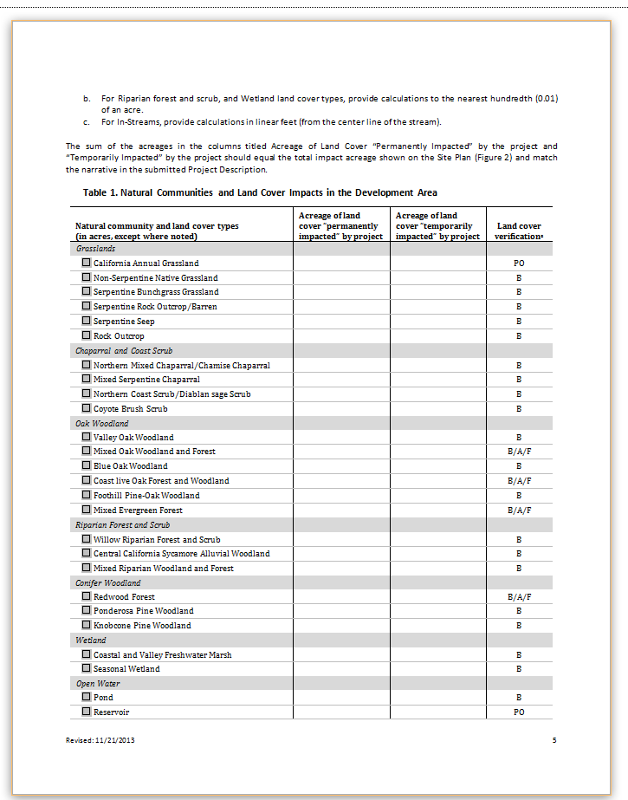
Existing Conditions and Impacts
Item 3: Land Cover Types and Impacts
Verification of land cover (36 land cover types)
Permanent vs. Temporary Impacts
Documentation

Slide 54
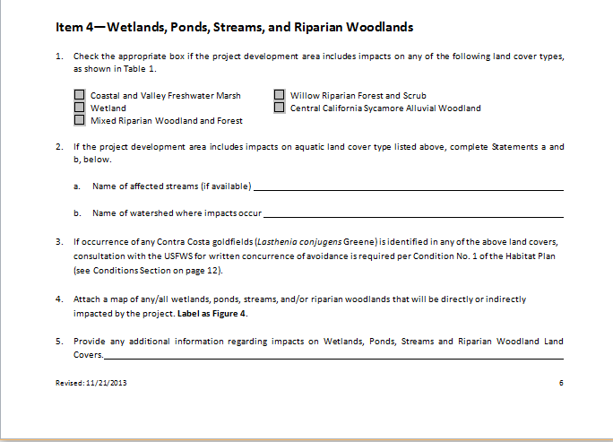
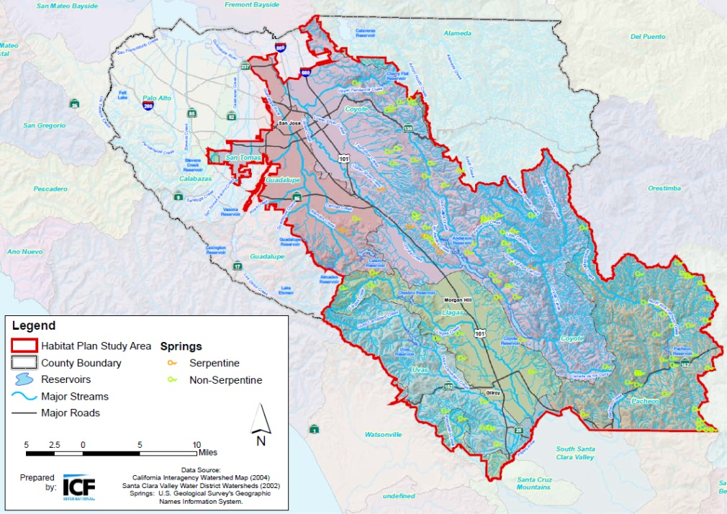
Existing Conditions and Impacts
Item 4: Wetland, Ponds, Streams, and Riparian Woodlands
Verification of wetland, pond, streams, or riparian woodlands on site
Name of affected streams
Name of watershed where impacts occur
Map of impacted wetland, pond, streams, or riparian woodlands

Slide 55
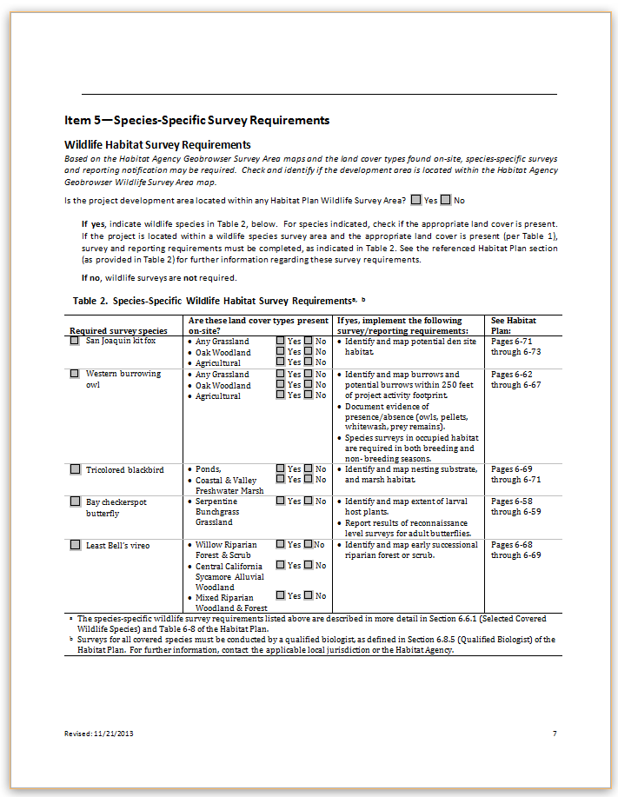
Existing Conditions and Impacts
Item 4: Species-Specific Survey Requirements
Wildlife Habitat Survey Requirements and Results
Which covered wildlife species require surveys?
  San Joaquin kit fox
  Western burrowing owl
  Tricolored blackbird
  Bay checkerspot butterfly
  Least Bell’s vireo
How are required surveys determined?
  Location
  Land cover type
How are required surveys documented?

Slide 56
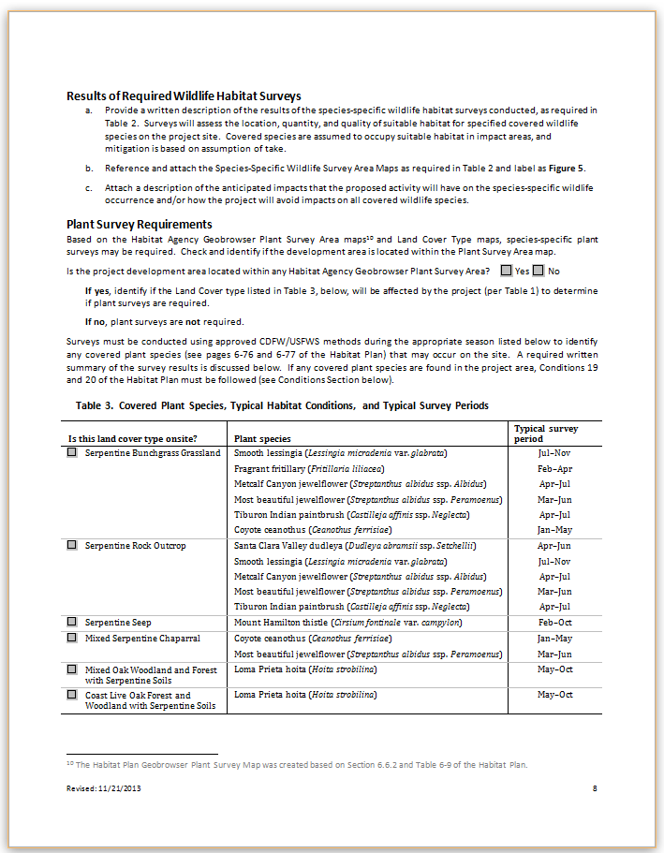
Existing Conditions and Impacts
Item 4: Species-Specific Survey Requirements
Plant Survey Requirements and Results
Which covered plant species require surveys?
How are required surveys determined?
How are required surveys documented?

Slide 57
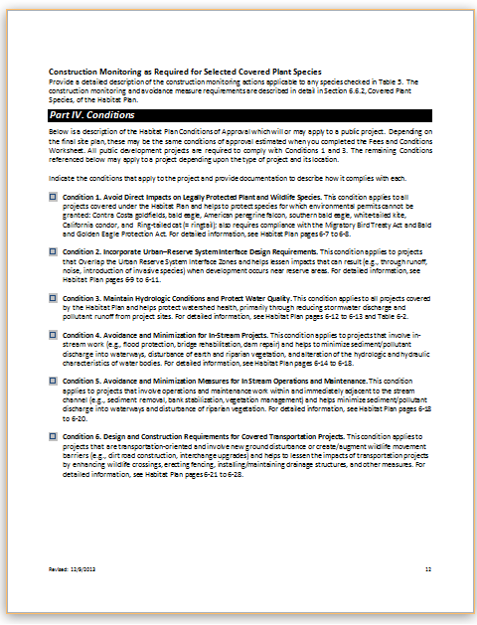
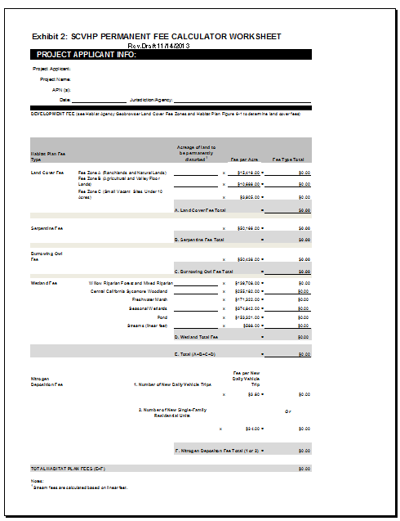
Conditions and Fees
Verify required conditions are applied
Verify fees calculated correctly

Slide 58
Pay Habitat Plan Fees / Take Coverage
Each co-Permittee will extend endangered species permits through a Determination of Consistency once the Habitat Plan Reporting Package is deemed complete, the conditions of approval have been established and imposed, and the required fees (if applicable) have been paid.

Slide 59
Contacts
City of Gilroy 7351 Rosanna St. Gilroy, CA 95020 Tel: (408) 846-0451 (408) 846-0429 www.ci.gilroy.ca.us/planning | City of Morgan Hill 17575 Peak Ave. Morgan Hill, CA 95037 Tel: (408) 778-6480 Fax: (408)779-7236 www.morganhill.ca.gov
City of San Jose 200 E. Santa Clara St., T-3 San Jose, CA 95113 Tel: (408) 535-3555 Fax: (408) 292-6055 www.sanjoseca.gov/planning | County of Santa Clara 70 West Hedding St., 7th Floor San Jose, CA 95110 Tel: (408) 299-5770 Fax: (408-288-9798 www.sccplanning.org
Santa Clara Valley Water District 5750 Almaden Expressway San Jose, CA 95118 (408) 265-2600 http://www.valleywater.org/ | Santa Clara Valley Transportation Authority 3331 North First Street San Jose, CA 95134 www.vta.org
Santa Clara Valley Habitat Agency 535 Alkire Avenue, Suite 100 Morgan Hill, CA 95037 (408) 779-7261 www.scv-habitatplan.org

Slide 60
Questions?

Slide 61
Thank you

