Slide 1
Santa Clara Valley Habitat Plan
Training
October 27, 2015
Notes:
Housekeeping
Introduce Jill and Joyce
Jill Mross is Management and Budget Analyst
Joyce Maskell is Land Acquisition and Contracting
Introduce Don Arnold and Janell Hillman
There will be no breaks
Refreshments

Slide 2
Overview
Understanding the Santa Clara Valley Habitat Plan
Permitting Resources and Process
Am I in or out?
Understanding the Application/Reporting Form
Case Studies

Slide 3
Part 1
Understanding the Santa Clara Valley Habitat Plan

Slide 4
Who Developed the Habitat Plan?
The Plan was prepared by six local agencies.
City of Gilroy.
City of Morgan Hill.
City of San José.
County of Santa Clara.
Santa Clara Valley Water District.
Santa Clara Valley Transportation Authority.
Notes:
Who’s here from….
In developing the Habitat Plan, the Co-Permittees worked with the two agencies responsible for applicable state and federal laws pertaining to endangered species: the U.S. Fish and Wildlife Service (USFWS) and the California Department of Fish and Wildlife (CDFW). USFWS and CDFW are collectively referred to as the Wildlife Agencies.
The Habitat Plan is administered by the Habitat Agency, an entity governed by the Local Partners. Among the Habitat Agency’s duties are monitoring and reporting on the implementation of the Habitat Plan.
When was the Habitat Plan Developed?
Original Local Partners bound by MOU (June 2004)
Santa Clara County
City of San Jose
Santa Clara Valley Water District
Santa Clara Valley Transportation Authority
New Partners added in 2005
City of Gilroy
City of Morgan Hill

Slide 5
Why a Regional Habitat Plan?
Endangered Species Permitting -- Business as Usual

Slide 6
What is the Habitat Plan?
50-year regional plan
Endangered species permits
Regulatory document and is not voluntary
Notes:
50-year regional plan to protect endangered species and other natural resources while allowing for orderly development throughout Santa Clara County.
Endangered species permits from the CDFW and USFWS for 50 years.
Regulatory document and is not voluntary.
50 year term based on
Time to implement covered activities
Time to implement conservation strategy
Time to secure adequate funding

Slide 7
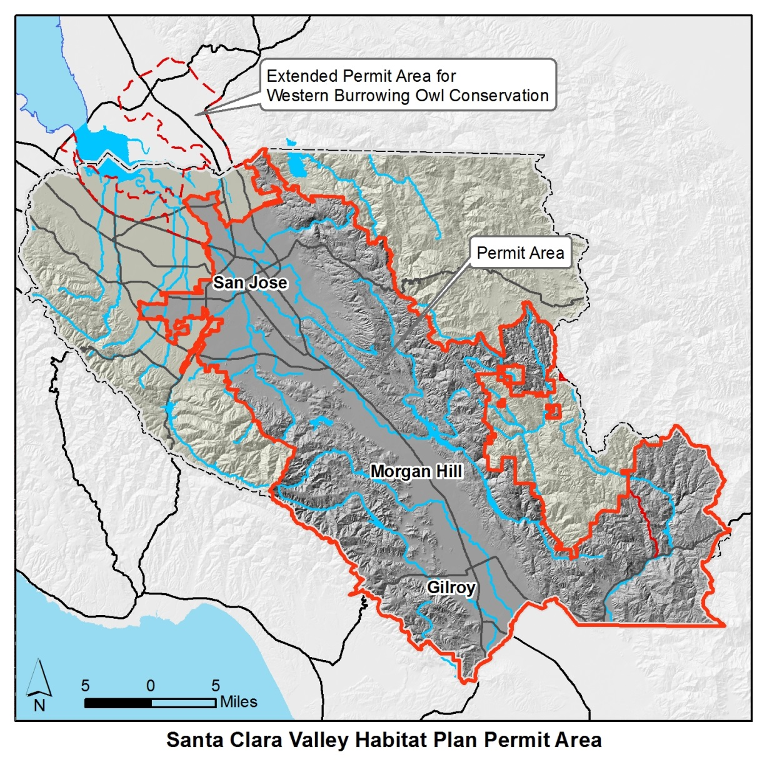
Permit Area
Permit Area Boundaries Defined by:
    All of City of San Jose except Baylands
    All of City of Morgan Hill and Gilroy
    Santa Clara County in Guadalupe, Coyote, and Pajaro Watersheds
    Excludes Henry Coe State Park
Notes:
Permit Area

Slide 8
Covered Activities
+ temporary project impacts
Notes:
Permanent Impacts = 18,000 acres
Additional temporary impacts assumed from In-stream Capital Projects, In-stream O&M, Rural Capital Projects, and Rural O&M
Temporary Impacts = 2,200 acres

Slide 9
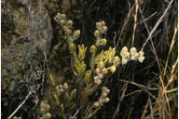
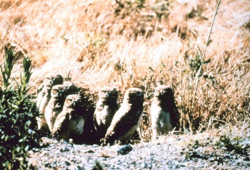
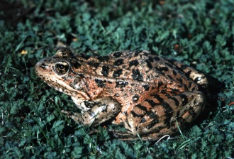
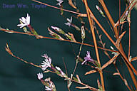
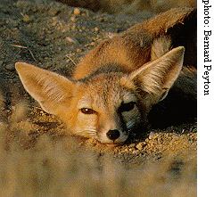
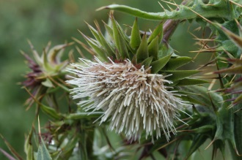
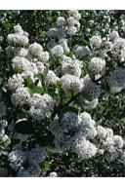
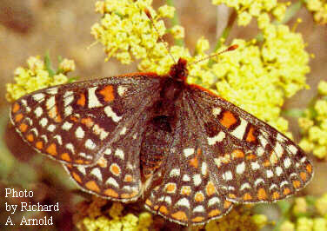
Provides Conservation for 18 Covered Species
Wildlife | Plants
Invertebrates | Tiburon Indian paintbrush
Bay checkerspot butterfly | Coyote ceanothus
Amphibians and Reptiles | Mount Hamilton thistle
California tiger salamander | Santa Clara Valley dudleya
California red-legged frog | Fragrant fritillary
Foothill yellow-legged frog | Loma Prieta hoita
Western pond turtle | Smooth lessingia
Birds | Metcalf Canyon jewelflower
Western burrowing owl | Most beautiful jewelflower
Least Bell’s vireo
Tricolored blackbird
Mammals
San Joaquin kit fox
© 2003 Dean Wm. Taylor
Golden eagle
© 2005 Janell Hillman
= survey requirements
Notes:
18 Covered Species

Slide 10
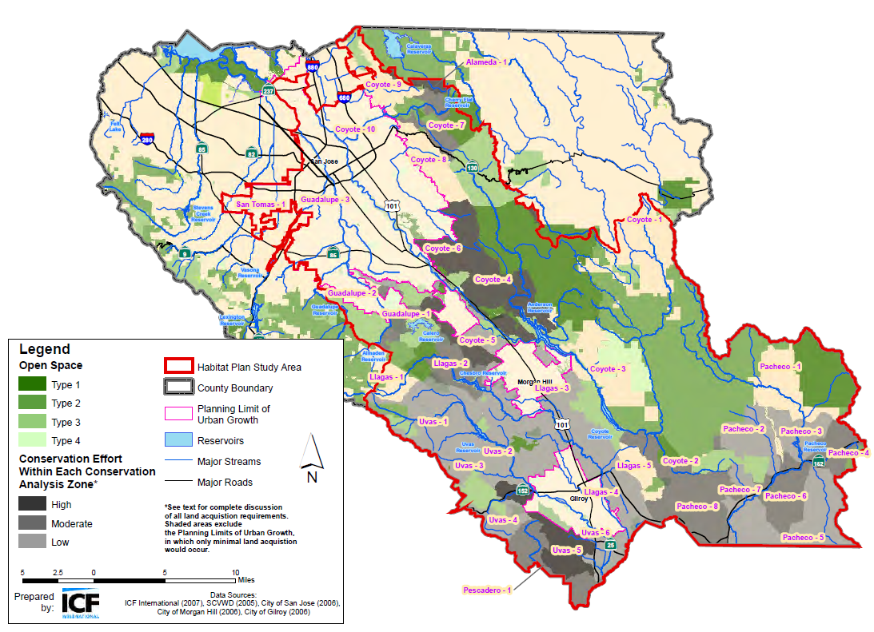
Conservation Strategy
Local Control and Increased Certainty for Project Permitting
Notes:
Protect 46,000 acres of land and 100 miles of streams
Restore 10 miles of streams and 70 acres to 428 acres of riparian woodland and wetlands
Create 20 to 72 acres of ponds

Slide 11
What are the Benefits of the Habitat Plan?
Local control. Allow local control of the extension of endangered species permits for local projects.
More efficient. Habitat Plan offers a more time efficient and simplified process to obtain endangered species permits for private and public projects, including operations and maintenance activities.
Increased certainty. Provides co-Permittees with greater certainty in mitigation requirements and timing.
Species recovery and land conservation. A regional approach to species recovery and land conservation

Slide 12
Permitting
Local Control and Increased Certainty for Project Permitting
USFWS
Endangered Species
CDFW
Endangered Species
U.S. Army Corps
(wetlands under 0.5 acres, stream under 300 linear feet)
Regional Board
Wetlands
(coming soon)
?
Business as Usual -Four permit stops
?
Santa Clara Valley Habitat Plan
Goal –
One permit stop
Notes:
Provide update on USACE permit
Includes NMFS BO
Emphasize permits

Slide 13
Questions?

Slide 14
Part 2
Permitting Resources and Process

Slide 15
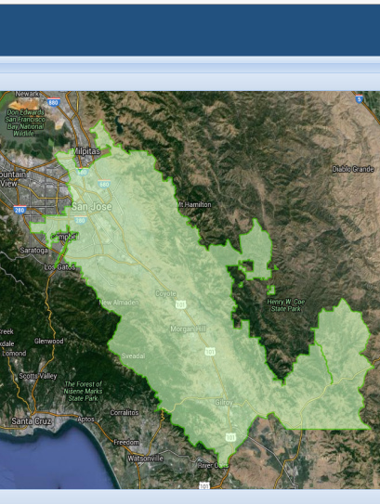
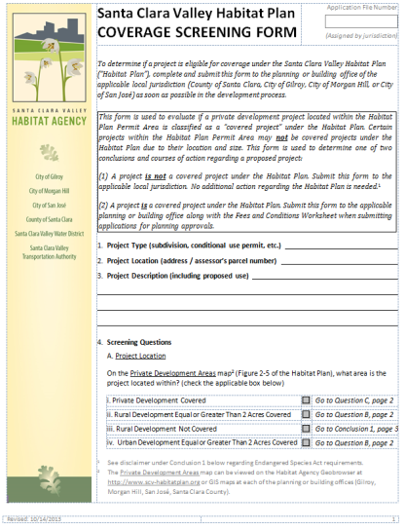

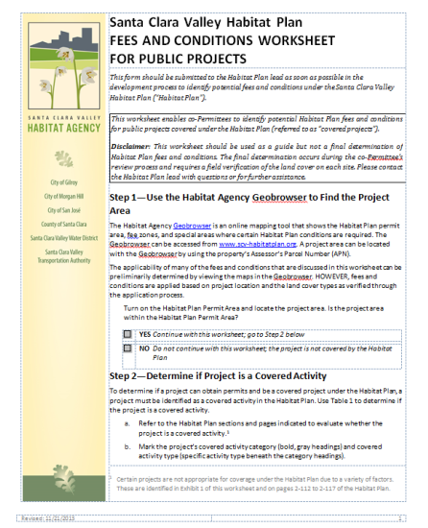
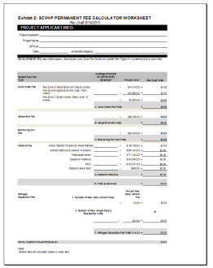
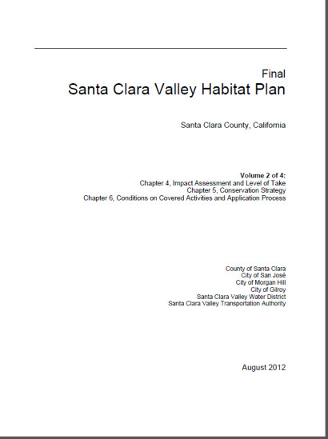
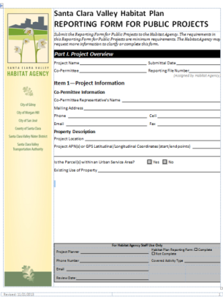
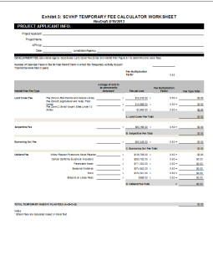
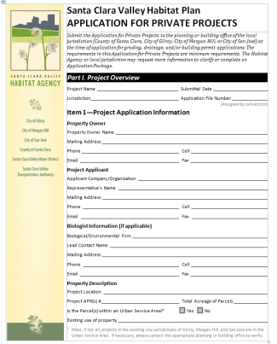
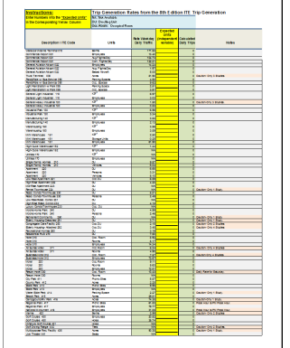
What Resources are Available?
Geobrowser
hcpmaps.com
Screening Form
Fees and Conditions Worksheet
Conditions Guidebook
New
Application/ Reporting Forms
Fee and Nitrogen Calculators
Santa Clara Valley Habitat Plan

Slide 16
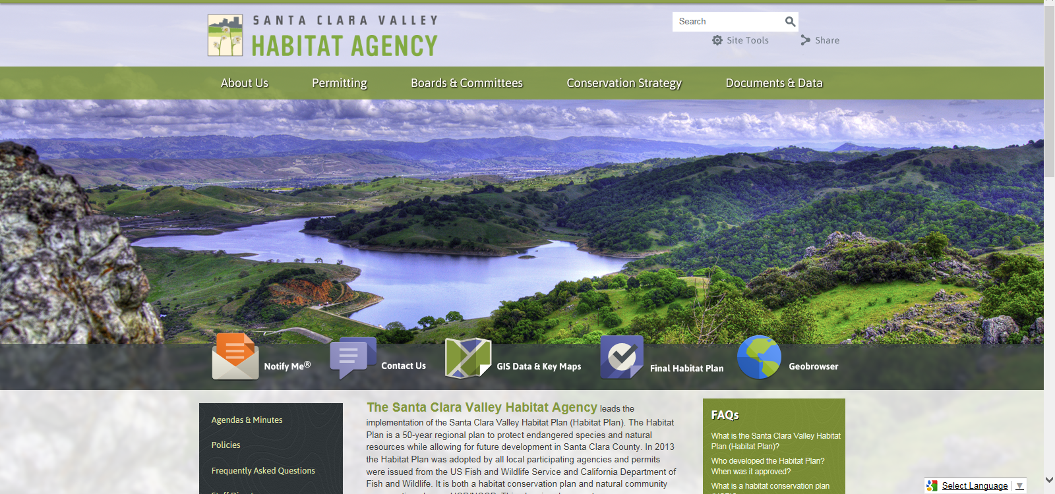
http://scv-habitatagency.org/

Slide 17
Do I have to Read the Habitat Plan?
Chapter | Key Information
2 | Covered Activities
3 | Land cover definitions for mapping
6 | Conditions on Covered Activities
9 | Calculating fees
 | Plan Interpretations
 | Policies

Slide 18
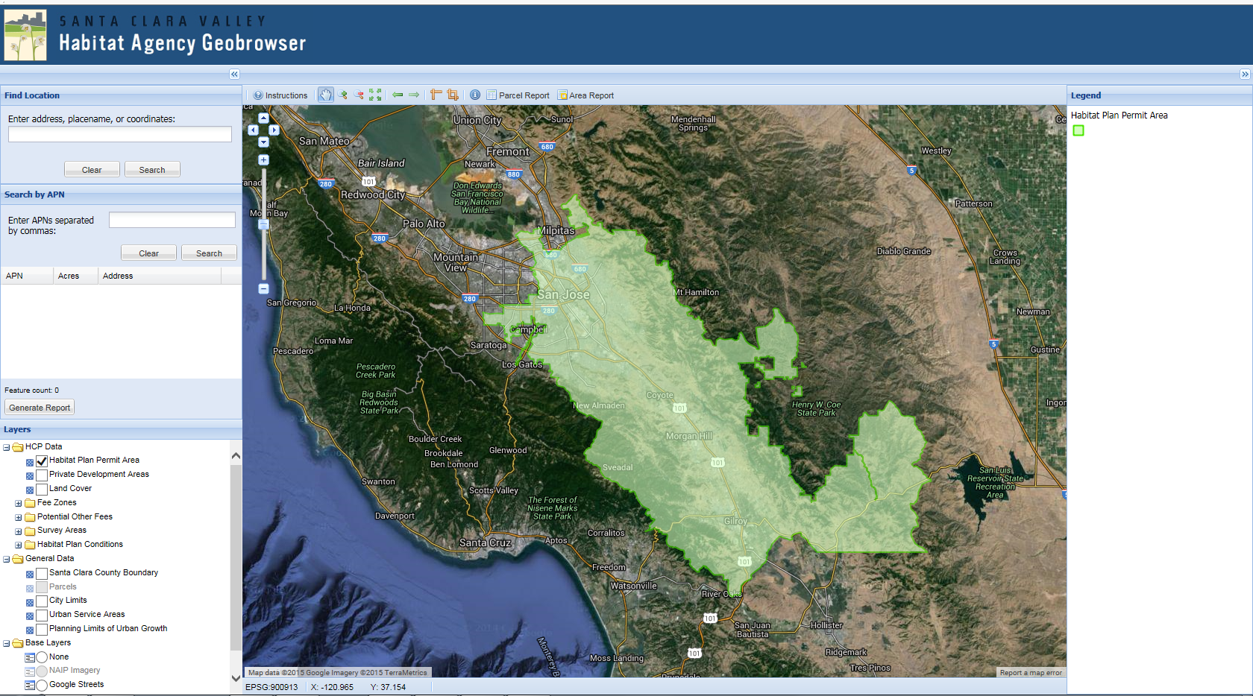
www.hcpmaps.com
Notes:
Terah – intro and APN

Slide 19
Resources and Tools
Website | http://scv-habitatagency.org
Geobrowser | www.hcpmaps.com
GIS data and submittal requirements | http://scv-habitatagency.org/193/GIS-Data-Key-Maps
Private Application Materials | http://scv-habitatagency.org/250/Private-Applicant
Public Reporting Materials | http://scv-habitatagency.org/278/Public-Agencies
PSE Application Materials | http://scv-habitatagency.org/270/Participating-Special-Entities
HCP Fee Schedule | http://scv-habitatagency.org/206/Habitat-Agency-Fee-Schedule
Final Habitat Plan, interpretations, policies | http://scv-habitatagency.org/178/Final-Habitat-Plan
Trainings | http://scv-habitatagency.org/298/Training
19
Notes:
19

Slide 20
Overview of the Compliance Process
Determine if project is a covered activity
Step 1
Verify Land Cover on Project Site
-------------------
Determine Conditions and Calculate Fees
Step 2
Complete, Submit, and Finalize Application/Reporting Package
Step 3
Pay Fees and Construct Project
------------------------------
Comply with Conditions
Step 4

Slide 21
How does the Habitat Plan Fit into the CEQA Process?
Timeline
Planning
CEQA
Comply with Conditions
Habitat Plan
1
4
Permitting
Design
Construction

Slide 22
What about Section 7?
Determine if ESA Section 7 consultation is required
Federal Agency consults with USFWS and/or NMFS
Biological Opinion issued by USFWS consistent with Habitat Plan requirements

Slide 23
Paradigm Shift
Not all species are covered and not all projects are covered, so it is important to find out if your species or project is covered. If you are working in the permit area, there is a good chance your project is covered.
You can address the 18 covered species through the Habitat Plan, but may have to address additional species through the CEQA process (e.g., American badger, dusky-footed woodrat, golden eagle, Hall’s bush mallow)
  Habitat Plan pre-determines species distribution and survey requirements for covered species.
  No additional mitigation measures needed for the Habitat Plan species and sensitive resources addressed.
Notes:
In the CEQA document, Habitat Plan compliance will streamline biological resources section and the cumulative resources section for the covered species.
Nitrogen deposition will need to addressed for serpentine species and refer to traffic section, mitigation is paying the fee.

Slide 24
CEQA considerations outside the Permit Area
Your project may have impacts:
  Burrowing Owl
  Nitrogen Deposition
Notes:
Burrowing Owl Breeding Habitat = XXX
Nitrogen Deposition from new vehicle trips, new residences

Slide 25
Questions?
Notes:
Chapter 3
Chapter 6

Slide 26
Part 3
Am I In or Out?

Slide 27
Overview of the Compliance Process
Determine if project is a covered activity
Step 1
Verify Land Cover on Project Site
-------------------
Determine Conditions and Calculate Fees
Step 2
Complete, Submit, and Finalize Application/Reporting Package
Step 3
Pay Fees and Construct Project
------------------------------
Comply with Conditions
Step 4

Slide 28

Private Projects

Slide 29
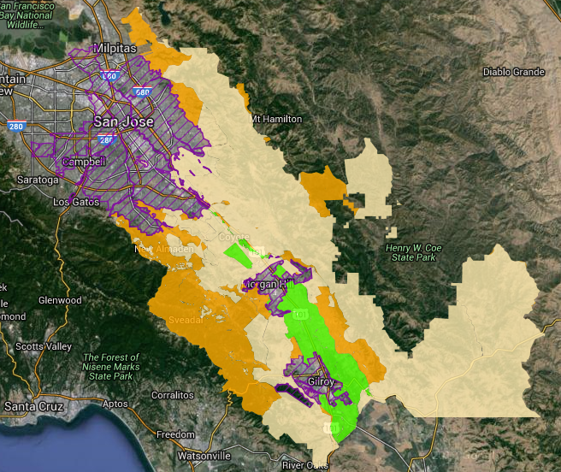
Private Projects
Location
Project Size
Currently Developed?
Sensitive Habitats
Area 4
Area 1
Area 2
Area 3
Notes:
Area 1 = You are subject to the Habitat Plan unless:
- Your site is currently developed and new development is less than 5000 ft

Slide 30
Private Projects
Is the site currently developed?
Is your project less than 5,000 ft2?
Are sensitive habitats present?
Area 1
Notes:
Area 1 = You are subject to the Habitat Plan unless:
- Your site is currently developed and new development is less than 5000 ft and no sensitive habitats are present.

Slide 31
Private Projects
Is your project 2 or more acres?
Are sensitive habitats present?
Area 2
Notes:
Area 2 =
Is the permanently disturbed footprint greater than 2 acres?

Slide 32
Private Projects
Are sensitive habitats present?
Area 3
Notes:
Area 3 = You are subject to the habitat plan only if sensitive habitats are present

Slide 33
Private Projects
Is your project 2 or more acres?
Are sensitive habitats present?
Area 4

Slide 34
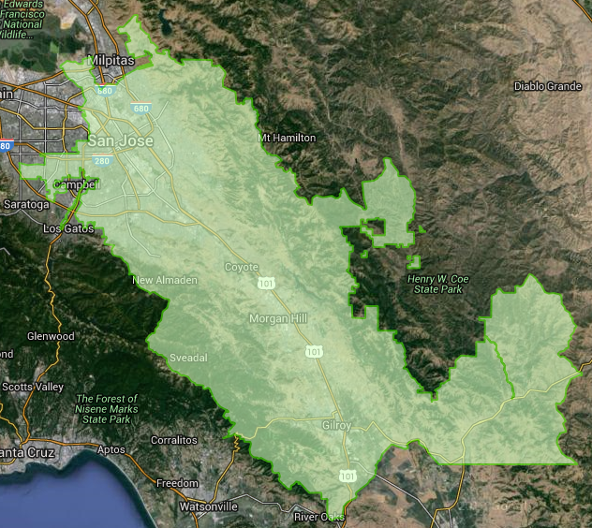
Public Projects
Congratulations! You are in.
Notes:
Chapter 2 lists all the covered activities
The end of Chapter 3 list
Exempt projects listed in Chapter 6

Slide 35
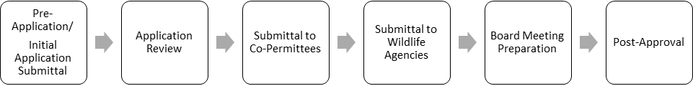
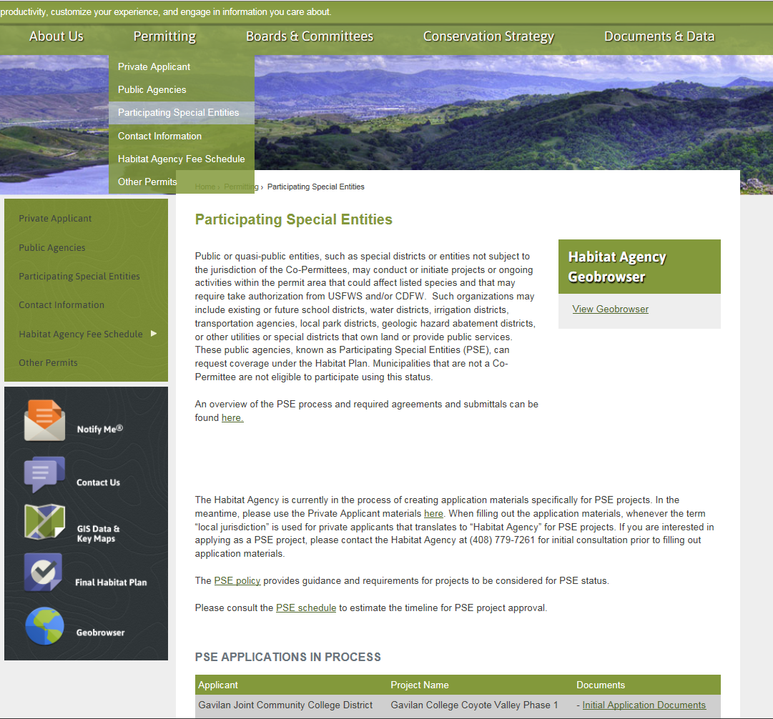
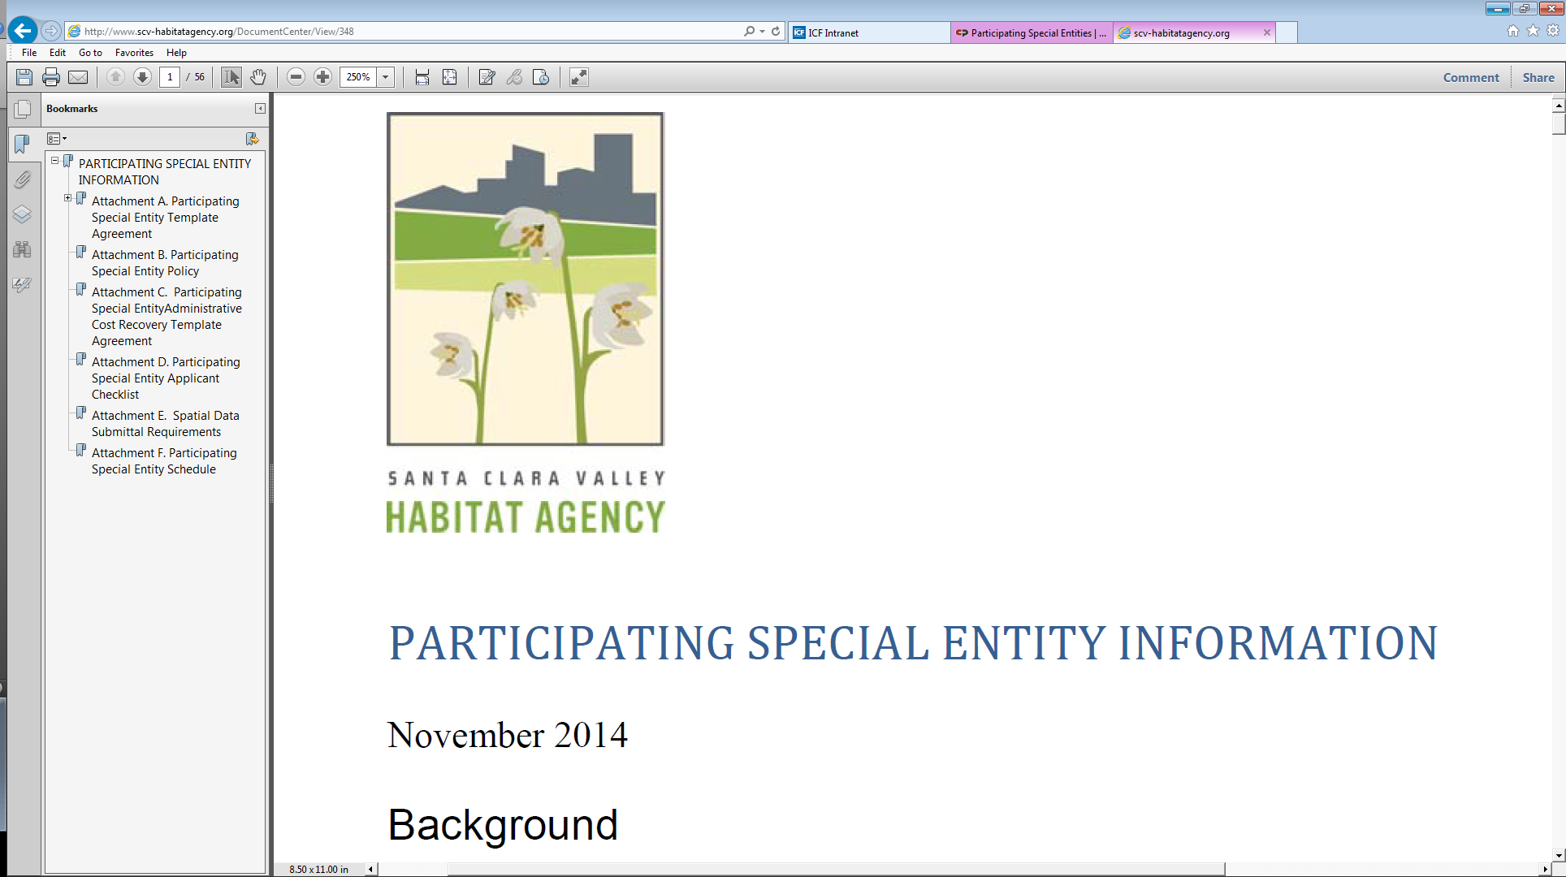
Participating Special Entities Projects
Notes:
Chapter 2 lists all the covered activities
The end of Chapter 3 list
Exempt projects listed in Chapter 6

Slide 36
Questions?
Notes:
Chapter 3
Chapter 6

Slide 37
Part 4
Understanding the Application/Reporting Package

Slide 38

Key Resources
Geobrowser
hcpmaps.com
Fees and Conditions Worksheet
Application/ Reporting Forms
+ Conditions Guidebook, Fee and Nitrogen Calculators, Santa Clara Valley Habitat Plan

Slide 39
Habitat Plan Application/Reporting Package
All Projects
 | Application/Reporting Form Project Description Vicinity Map Site Plan Documentation of compliance with conditions Fee Calculator Worksheets Qualified Biologist Resume*
Projects with Temporary Impacts
 | Site photograph of temporary impacts
Projects with impacts to wetland, ponds, streams, or riparian woodlands
 | Map of Wetlands, Ponds, Streams, and Riparian Woodlands
Projects located inside the urban service area and is 10 acres or larger or outside the urban service area (in rural areas)
 | GIS files

Slide 40
Overview of the Compliance Process
Determine if project is a covered activity
Step 1
Verify Land Cover on Project Site
-------------------
Determine Conditions and Calculate Fees
Step 2
Complete, Submit, and Finalize Application/Reporting Package
Step 3
Pay Fees and Construct Project
------------------------------
Comply with Conditions
Step 4

Slide 41
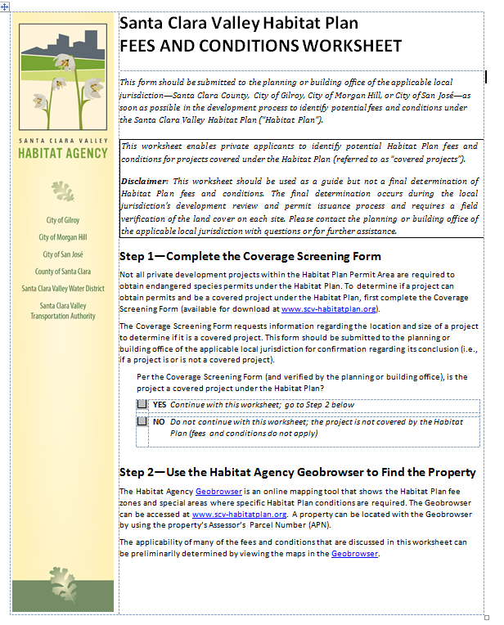
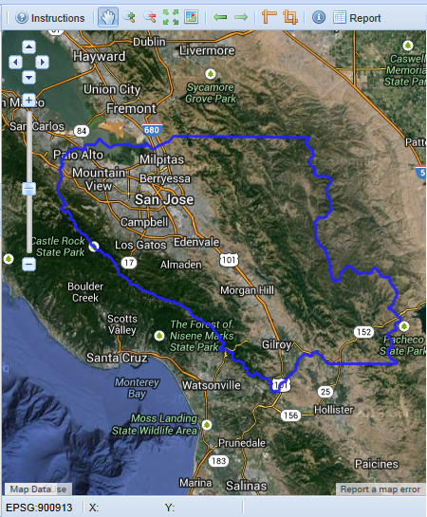
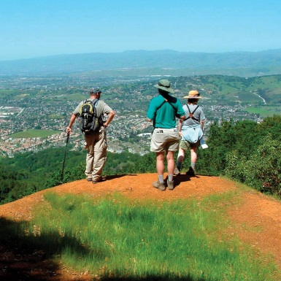
Verify Land Cover on Project Site
-------------------
Determine Conditions and Calculate Fees
Step 2
Land Cover
How do I determine and document the land cover on the property?
Conditions
How do I determine which Habitat Plan conditions apply to a project?
Fees
How do I determine which Habitat Plan fees apply to a project?
How are the fees calculated?

Slide 42
Land Cover
Mapping and Defining Impacts

Slide 43
Verify Land Cover
Land Cover (37 types, Table 3-2) | Field Verification Method
Disturbed / Common - Grassland, Grain, Row Crop, Urban-Suburban, Rural-Residential, Golf Courses/Urban Parks, | Site Plans, Site Photos Planning or building office staff may also use aerial photos or a site visit for verification
Woodland - Mixed Oak Woodland and Forest, Other Forests and Woodlands | Mapping by Arborist, Forester, or Qualified Biologist Requires site visit and mapping of land covers
Sensitive / Natural - Serpentine Bunchgrass Grassland, Northern Mixed Chaparral, Riparian and Wetlands | Mapping by a Qualified Biologist Requires site visit mapping of land covers
Notes:
Habitat Plan Mapping – 10 acre scale
Verify Land Cover – confirms fees /conditions
Chapter 3 of the Habitat Plan has land cover definitions

Slide 44
Defining Impacts
Public & Private Projects
Urban Areas & < 10 acres | Urban & > 10 acres Rural Areas
Entire Parcel | Development area Project Footprint + 50’ buffer or 10’ buffer
Other Factors –
Linear Public Projects (Urban & Rural) – Footprint Only
Temporary Impacts – Up to 1 year of disturbance and returns to pre-project conditions within year 1 post-impact.
Notes:
Shows the variety of considerations for impacts
Location (Urban Rural)
Size above/below 10 acres, 0.25 ac of temp impacts if no sensitive lancovers impacted.
Duration

Slide 45
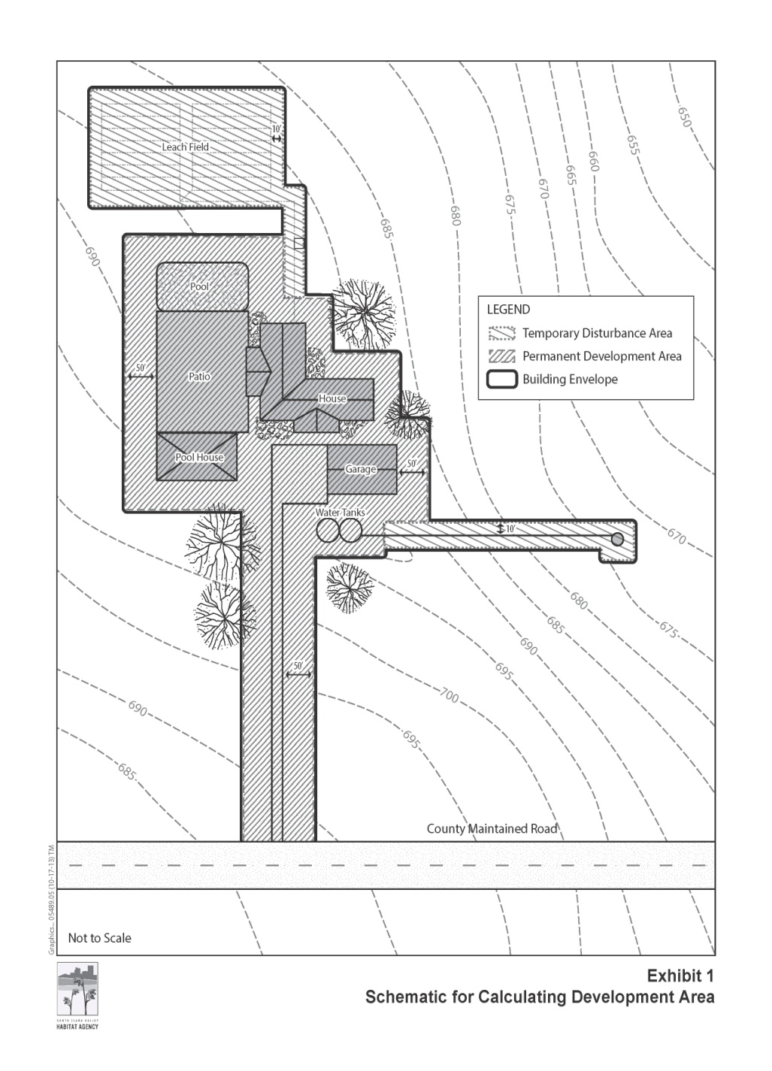
Development area
Permanent + 50’
Temporary + 10’

Slide 46
Determine Conditions

Slide 47
Conditions
Triggers
Timeline
Documentation
Notes:
Triggers =
All projects
Project types
Land cover present
Habitat present
Timeline =
Planning and Design, AMMs, Post-construction, O&M
Seasonally appropriate
Documentation =
With Application/Reporting Package
Prior/Post construction, depending on the condition

Slide 48
Conditions
All Covered Projects
Covered Project Categories
Natural Communities
Condition 1
Condition 3
Urban Development
Condition 2
In-Stream Projects
Condition 4
In-Stream O&M
Condition 5
Rural Transportation Projects
Condition 6
Rural Development Projects
Condition 7
Rural O&M
Condition 8
Reserve System Implementation
Condition 9
Condition 10
Stream and Riparian
Condition 11
Wetland and Pond
Condition 12
Serpentine
Condition 13
Valley and Blue Oak
Condition 14
Wildlife
Bay Checkerspot Butterfly
Condition 13
Western Burrowing Owl
Condition 15
Least Bell’s Vireo
Condition 16
Tricolored Blackbird
Condition 17
San Joaquin kit fox
Condition 18
Plants
Plant Salvage
Condition 19
Plant Avoidance and Minimization
Condition 20
Notes:
Triggers to Conditions

Slide 49
How does the Habitat Plan Fit into the CEQA Process?
Timeline
Planning
CEQA
Comply with Conditions
Habitat Plan
1
4
Permitting
Design
Construction
Notes:
Example of Timeline considerations

Slide 50
Conditions
All Covered Projects
Covered Project Categories
Natural Communities
Condition 1
Condition 3
Urban Development
Condition 2
In-Stream Projects
Condition 4
In-Stream O&M
Condition 5
Rural Transportation Projects
Condition 6
Rural Development Projects
Condition 7
Rural O&M
Condition 8
Reserve System Implementation
Condition 9
Condition 10
Stream and Riparian
Condition 11
Wetland and Pond
Condition 12
Serpentine
Condition 13
Valley and Blue Oak
Condition 14
Wildlife
Bay Checkerspot Butterfly
Condition 13
Western Burrowing Owl
Condition 15
Least Bell’s Vireo
Condition 16
Tricolored Blackbird
Condition 17
San Joaquin kit fox
Condition 18
Plants
Plant Salvage
Condition 19
Plant Avoidance and Minimization
Condition 20
Notes:
Always applied
Reinforces existing wildlife laws and permitting programs (NPDES).

Slide 51
Condition 1: Avoid Direct Impacts on Legally Protected Plant and Wildlife Species
Applies to all projects
Avoid impacts to other listed and fully protected species, comply with MBTA and BGEPA (Key requirements of condition)
When do you apply
Planning | X
Design | X
Construction | X
Post-Construction | X
O&M | X
Contra Costa goldfields, bald eagle, American peregrine falcon, southern bald eagle, white‐tailed kite, California condor, and Ring‐tailed cat (= ringtail)
Notes:
Where Applied:
Seasonal Wetland habitat- Contra Costa Goldfields
Riparian Woodland habitat - Ring-tailed cat (Ringtail)
Removal of Large Trees - Raptors (Eagles, Falcon, Kite, Condor)
Applicable Geobrowser Maps:
Land Cover - Seasonal Wetlands (Goldfields), Riparian Woodland (Ringtail)
Why do we apply:
Protect species for which environmental permits cannot be granted: Contra Costa goldfields, bald eagle, American peregrine falcon, southern bald eagle, white‐tailed kite, California condor, and Ring‐tailed cat (= ringtail); also requires compliance with the Migratory Bird Treaty Act and Bald and Golden Eagle Protection Act
At Project Design:
Plant surveys by a qualified plant biologist during initial wetland delineation to determine if Contra Costa Goldfields are present
At Project Construction
Pre-construction surveys to determine presence of Ringtail and bird species protected by MBTA and BGEPA

Slide 52
Condition 3: Maintain Hydrologic Conditions and Protect Water Quality
Applies to all projects
Protect watershed health, primarily through reducing stormwater discharge and pollutant runoff from project sites
When do you apply
Planning | X
Design | X
Construction | X
Post-Construction | X
O&M
Conditions 3, 4, and 5
A series of tables was developed to identify which avoidance and minimization measures may apply to your project.
Notes:
Why do we apply:
Protect watershed health, primarily through reducing stormwater discharge and pollutant runoff from project sites.
The Habitat Plan identifies site design and avoidance and minimization measures that are consistent with and complementary to National Pollutant Discharge Elimination System (NPDES) permits.
The conditions fall into three general categories: project design, construction, and post-construction avoidance and minimization measures.
Project design measures are site design planning approaches that protect water
quality by preventing and reducing the adverse impacts of stormwater pollutants
and increases in peak runoff rate and volume. They include hydrologic source
control measures that focus on the protection of natural resources and the
reduction of impervious surfaces.
Construction site conditions include sourceand treatment control measure to prevent pollutants from leaving the construction
site and minimizing site erosion and local stream sedimentation during construction.
Post-construction conditions include measures for municipal operations, stormwater treatment, and flow control.

Slide 53
Conditions
All Covered Projects
Covered Project Categories
Natural Communities
Condition 1
Condition 3
Urban Development
Condition 2
In-Stream Projects
Condition 4
In-Stream O&M
Condition 5
Rural Transportation Projects
Condition 6
Rural Development Projects
Condition 7
Rural O&M
Condition 8
Reserve System Implementation
Condition 9
Condition 10
Stream and Riparian
Condition 11
Wetland and Pond
Condition 12
Serpentine
Condition 13
Valley and Blue Oak
Condition 14
Wildlife
Bay Checkerspot Butterfly
Condition 13
Western Burrowing Owl
Condition 15
Least Bell’s Vireo
Condition 16
Tricolored Blackbird
Condition 17
San Joaquin kit fox
Condition 18
Plants
Plant Salvage
Condition 19
Plant Avoidance and Minimization
Condition 20
Notes:
9 is for Recreation Plans on Reserve Lands
10 is for Fuel Buffer as mandated by State law (only on Reserve lands?)

Slide 54
Conditions
All Covered Projects
Covered Project Categories
Natural Communities
Condition 1
Condition 3
Urban Development
Condition 2
In-Stream Projects
Condition 4
In-Stream O&M
Condition 5
Rural Transportation Projects
Condition 6
Rural Development Projects
Condition 7
Rural O&M
Condition 8
Reserve System Implementation
Condition 9
Condition 10
Stream and Riparian
Condition 11
Wetland and Pond
Condition 12
Serpentine
Condition 13
Valley and Blue Oak
Condition 14
Wildlife
Bay Checkerspot Butterfly
Condition 13
Western Burrowing Owl
Condition 15
Least Bell’s Vireo
Condition 16
Tricolored Blackbird
Condition 17
San Joaquin kit fox
Condition 18
Plants
Plant Salvage
Condition 19
Plant Avoidance and Minimization
Condition 20

Slide 55
Condition 11: Stream and Riparian Setbacks
Applies to projects that overlap stream or stream setback
Minimize impacts on streams by specifying setbacks and buffer zones
Geobrowser: Category 1 Stream Buffers and Setbacks
When do you apply
Planning
Design | X
Construction | X
Post-Construction
O&M
Example
Protection of streams and adjacent riparian vegetation would conserve habitat.
Notes:
Why do we apply:
Minimize impacts on streams by specifying setbacks and buffer zones

Slide 56
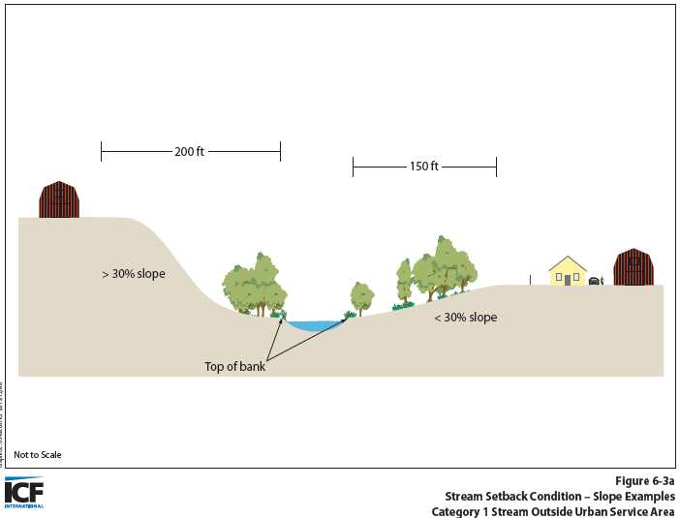
Condition 11
Example
Stream Setbacks outside Urban Service Area
Stream Category | Category 1 Streams |  | Category 2 Streams
Slope Class | Inside Existing Urban Service Area | Outside Existing Urban Service Area
0-30% | 100 feet | 150 feet | 35 feet
>30% | 150 feet | 200 feet
Notes:
Location of project (Urban/Rural)
Slope (30%)
Cat 1 or Cat 2 (does It support covered species)
Now an ordinance not a policy or “recommendation”

Slide 57
Conditions
All Covered Projects
Covered Project Categories
Natural Communities
Condition 1
Condition 3
Urban Development
Condition 2
In-Stream Projects
Condition 4
In-Stream O&M
Condition 5
Rural Transportation Projects
Condition 6
Rural Development Projects
Condition 7
Rural O&M
Condition 8
Reserve System Implementation
Condition 9
Condition 10
Stream and Riparian
Condition 11
Wetland and Pond
Condition 12
Serpentine
Condition 13
Valley and Blue Oak
Condition 14
Wildlife
Bay Checkerspot Butterfly
Condition 13
Western Burrowing Owl
Condition 15
Least Bell’s Vireo
Condition 16
Tricolored Blackbird
Condition 17
San Joaquin kit fox
Condition 18
Plants
Plant Salvage
Condition 19
Plant Avoidance and Minimization
Condition 20
Notes:
Condition 13 is both natural community and species focused.

Slide 58
Species Surveys
Surveys for these wildlife species: | Are required for projects located within: | Where the one of following land cover types is present:
Western burrowing owl | Occupied burrowing owl nesting habitat as defined by the Habitat Plan | N/A
Least Bell’s vireo | Least Bell’s vireo breeding habitat in South County | Riparian Forest and Scrub
Tricolored blackbird | Tricolored blackbird breeding habitat | Pond, Coastal & Valley Freshwater Marsh
San Joaquin kit fox | San Joaquin kit fox denning habitat | Any Grassland, Oak Woodland, Agricultural
Bay checkerspot butterfly | Serpentine bunchgrass grassland | Serpentine Bunchgrass Grassland
Notes:
Go to geobrowser

Slide 59
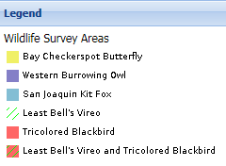
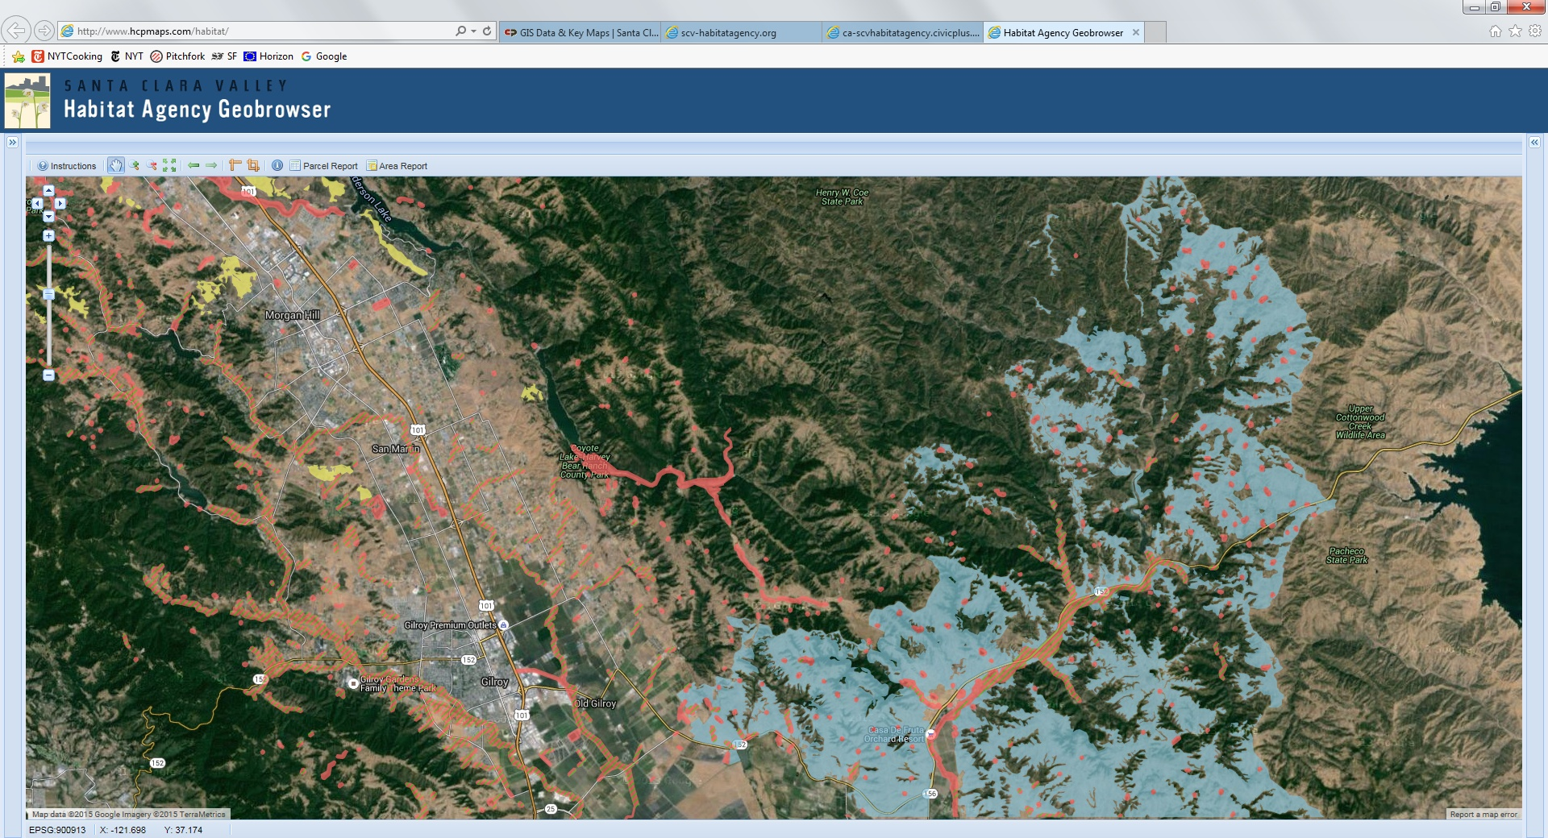
Wildlife Survey Areas

Slide 60
Conditions
All Covered Projects
Covered Project Categories
Natural Communities
Condition 1
Condition 3
Urban Development
Condition 2
In-Stream Projects
Condition 4
In-Stream O&M
Condition 5
Rural Transportation Projects
Condition 6
Rural Development Projects
Condition 7
Rural O&M
Condition 8
Reserve System Implementation
Condition 9
Condition 10
Stream and Riparian
Condition 11
Wetland and Pond
Condition 12
Serpentine
Condition 13
Valley and Blue Oak
Condition 14
Wildlife
Bay Checkerspot Butterfly
Condition 13
Western Burrowing Owl
Condition 15
Least Bell’s Vireo
Condition 16
Tricolored Blackbird
Condition 17
San Joaquin kit fox
Condition 18
Plants
Plant Salvage
Condition 19
Plant Avoidance and Minimization
Condition 20

Slide 61
Condition 19: Plant Salvage when Impacts are Unavoidable
Applies to projects that Cannot avoid impacts on covered plants
Protects covered plants by prescribing salvage as an option whenever avoidance of impacts is not feasible
Geobrowser: Plant Survey Areas (field verification required)
When do you apply
Planning
Design | X
Construction | X
Post-Construction | X
O&M | X
Notes:
Project proponent must submit advance notification of impact (in advance of full application submittal) to HA.
Impacts may not occur prior to an offset of occurrences within the Reserve System (Stay Ahead Provision).
HA will confirm available take for plant impacts.
Project proponent must then ask if HA wishes to salvage the occurrence.
Need enough lead time to allow salvage activities in advance of impact.

Slide 62
Condition 20: Avoid and Minimize Impacts to Covered Plant Occurrences
Applies to projects located in areas where covered plant species are likely to occur and within a covered plant survey area
Requires plant surveys, specific avoidance and minimization practices (e.g., using seclusion fencing), and monitoring for selected plant species
Geobrowser: Plant Survey Areas (field verification required)
When do you apply
Planning
Design | X
Construction | X
Post-Construction | X
O&M | X
Notes:
There are caps on the number of populations of a covered plant which can impacted, over the life of the Plan.
Document the condition of the population that will be impacted (age structure, reproductive success, pop size, threats, etc.)
In order to adequately assess impact, need to count or estimate total population size, and estimate portion impacted if population extends outside of project or impact area.
Partial or permanent impact assessment: less than 5% of total occurrence impacted = not a permanent impact; no monitoring required.
Partial impacts require monitoring:
Monitoring post-project: 5 yrs for annuals, 3 yrs for perennials
Reduction in long-term viability and take is assumed if there is a greater than a 25% decline in pop size from pre-project conditions.

Slide 63
Species Surveys
Surveys for these plants: | Are required for projects located within:
Smooth lessingia, fragrant fritillary, Metcalf canyon jewelflower, most beautiful jewelflower, Tiburon paintbrush, and Coyote ceanothus | Serpentine bunchgrass grassland or within 0.25 mile of a known occurrence
Santa Clara Valley dudleya, smooth lessingia, Metcalf canyon jewelflower, most beautiful jewelflower, and Tiburon paintbrush | Serpentine rock outcrop or within 0.25 mile of a known occurrence
Mount Hamilton thistle | Serpentine seep or within 0.25 mile of a known occurrence
Coyote ceanothus and most beautiful jewelflower | Mixed serpentine chaparral or within 0.25 mile of a known occurrence
Loma Prieta hoita | Mixed oak woodland and forest with serpentine soils or within 0.25 mile of a known occurrence
Loma Prieta hoita | Coast live oak forest and woodland with serpentine soils or within 0.25 mile of a known occurrence
Coyote ceanothus, Metcalf canyon jewelflower, most beautiful jewelflower, and smooth lessingia | Northern coastal scrub and Diablan sage scrub with serpentine soils or within 0.25 mile of a known occurrence
Notes:
Survey for covered plants in suitable habitat or within a quarter mile of a known occurrence

Slide 64
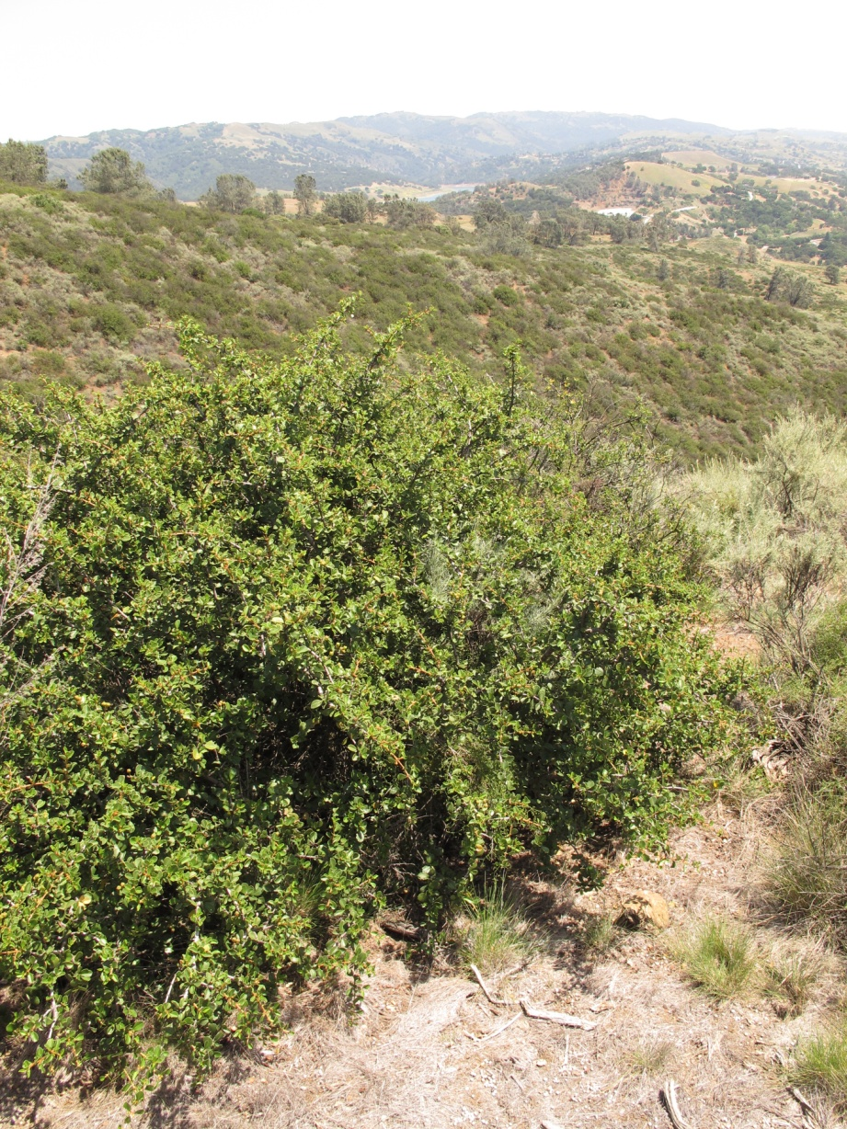
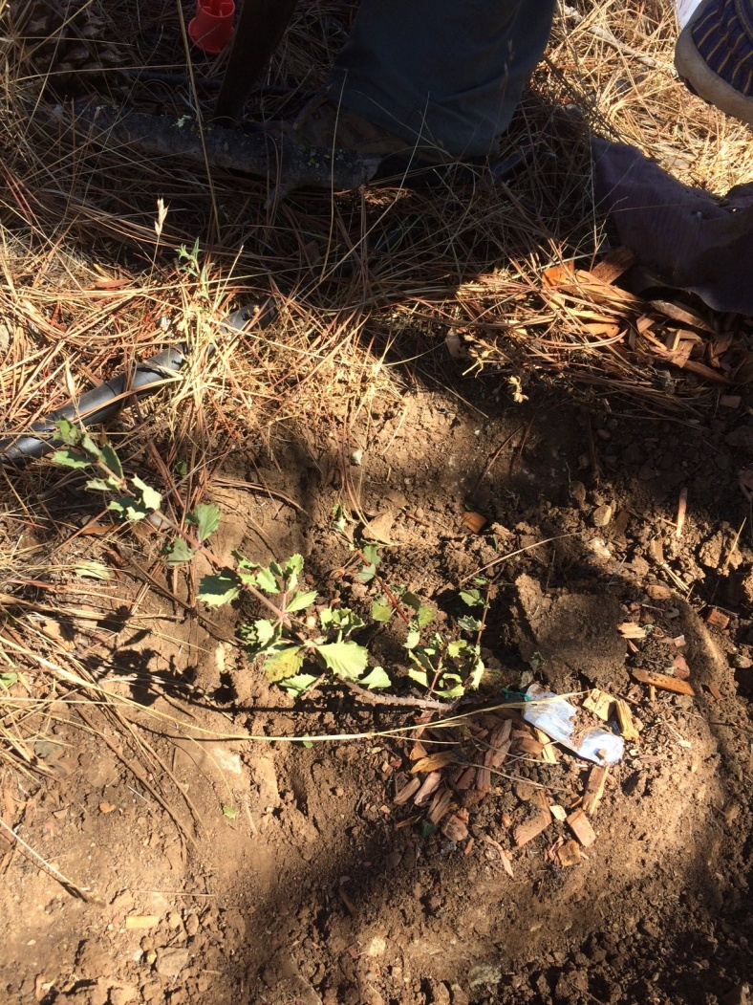
Phytophthora: An Emerging Threat to Covered Species
Infected Coyote ceanothus seedling
Notes:
Emerging issue/threat to covered plants & natural communities/land cover types
Water mold (Sudden Oak Death is one example); causes root rot, stem canker, or leaf blight
More than 120 spp. of Phyto described to date; wide host range
Spread thru contaminated soil
Primary vector = commercially-produced nursery stock;
Planting infected stock for restoration can introduce Phyto into native habitats

Slide 65
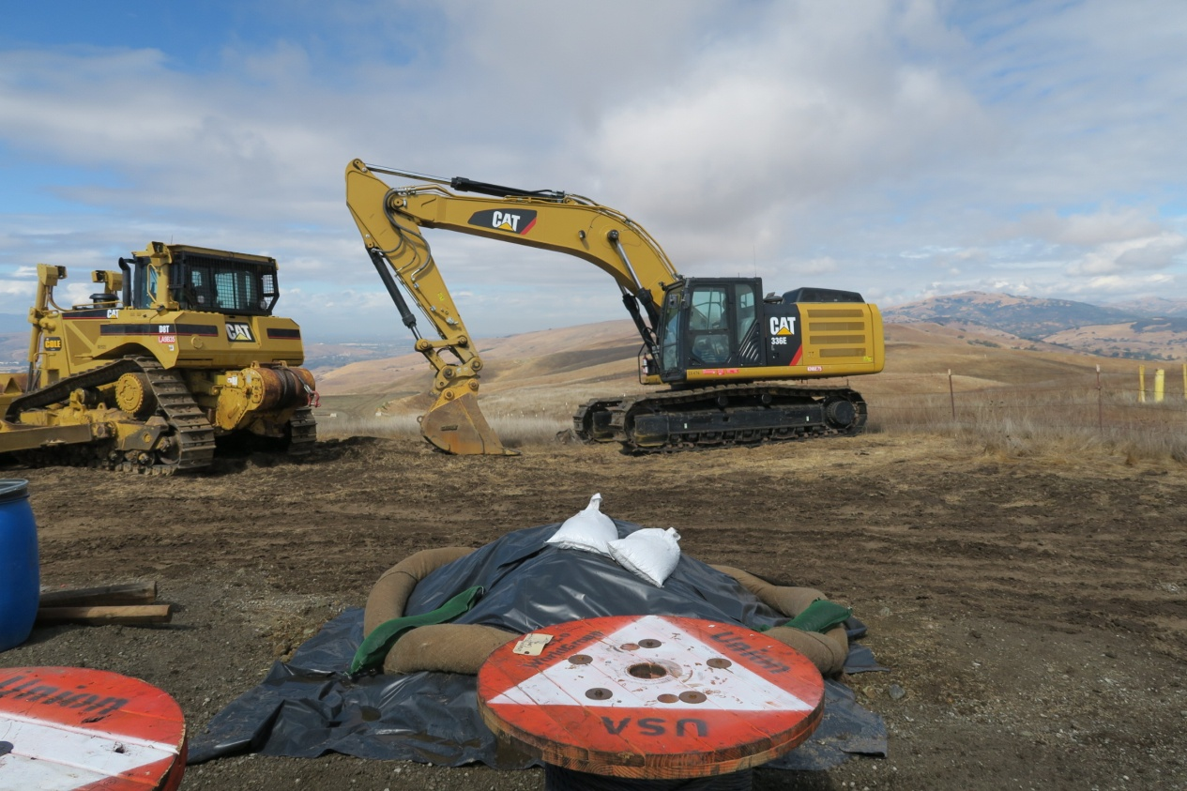
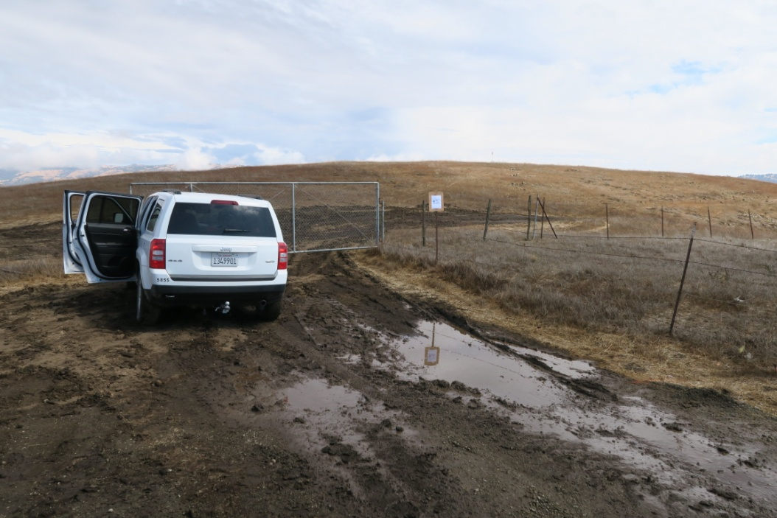
Phytophthora: An Emerging Threat to Covered Species
Notes:
Secondary spread of pathogen occurs thru movement of contaminated soil on shoes, tires, tools, equipment.
Pathogen can also spread along trails (ex SOD), move downslope with water, or upslope through host roots.

Slide 66
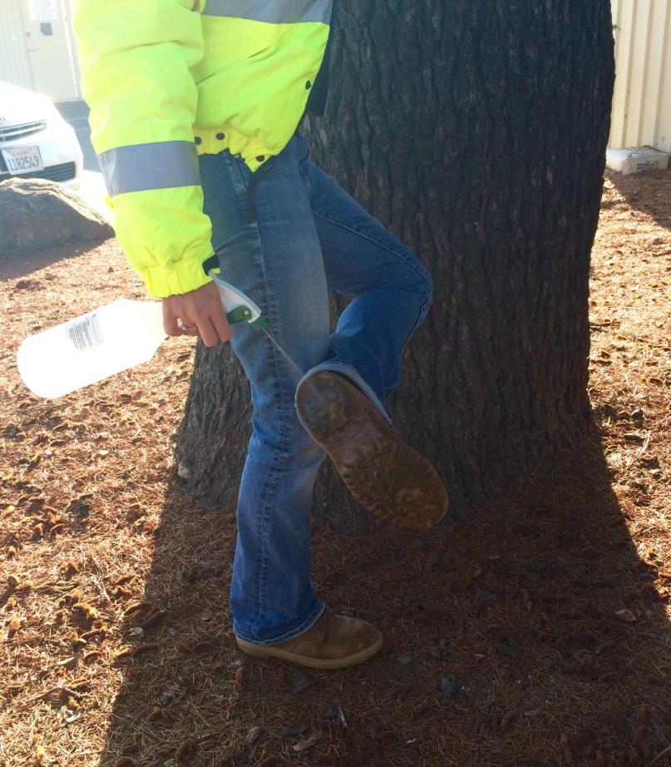
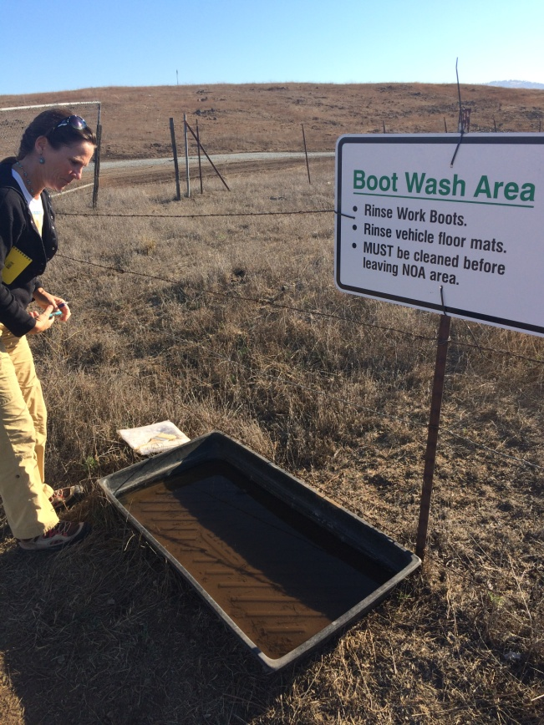
SCVWD Response to Pathogen Issue: Keep it Clean!
General Construction/
Operations and Maintenance BMP
Sensitive and Contaminated Site BMP
Nursery Contract Spec
Notes:
Targeted BMPs for SCVWD staff & Contractors
Phytosanitation by 70% isopropyl alcohol
Use of mobile wash stations, organizing work flow to sensitive sites first, contaminated sites separately.
Remediation options include solarization and steaming. Very challenging, best option is prevention!!!
HA AMM’s and BMP development to follow soon.

Slide 67
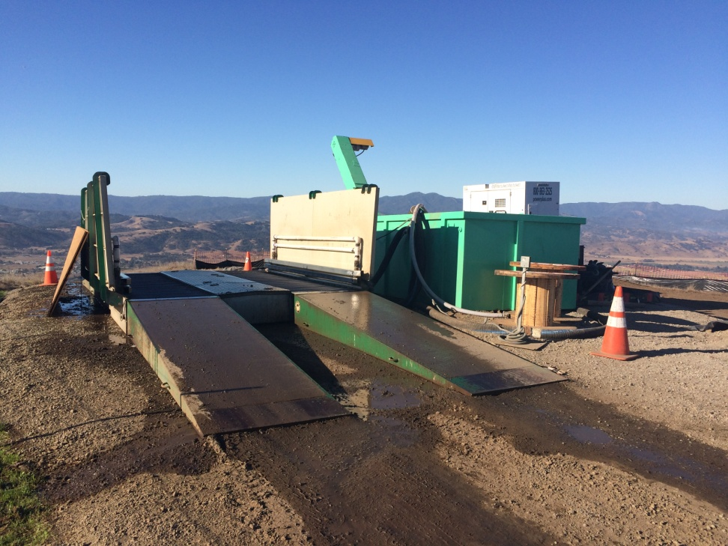
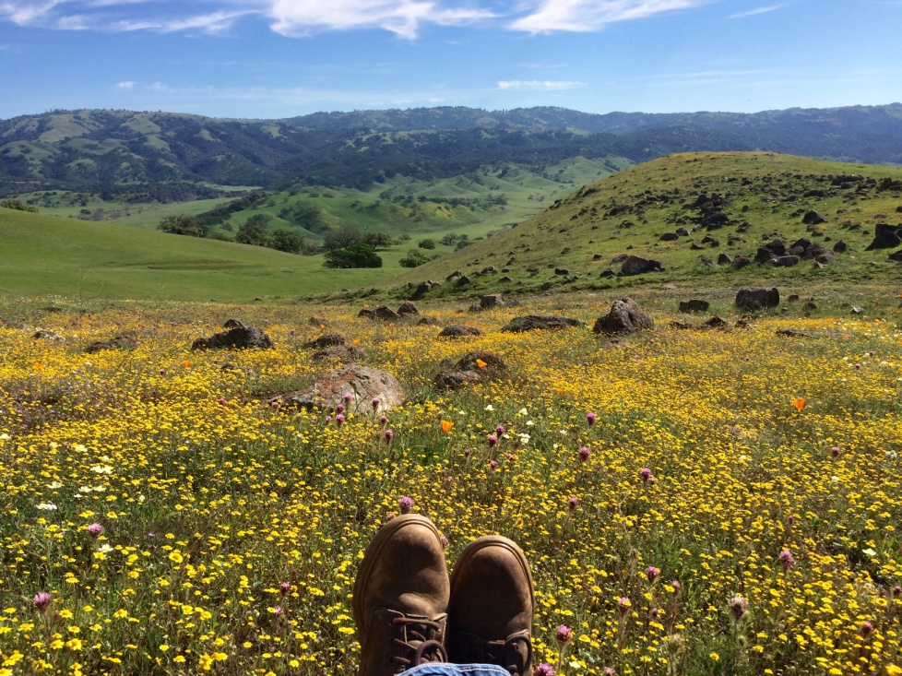
Compliance with Conditions in the Field
Notes:
We go to this extent, so that we can protect this!!!!!

Slide 68
Calculate Fees

Slide 69
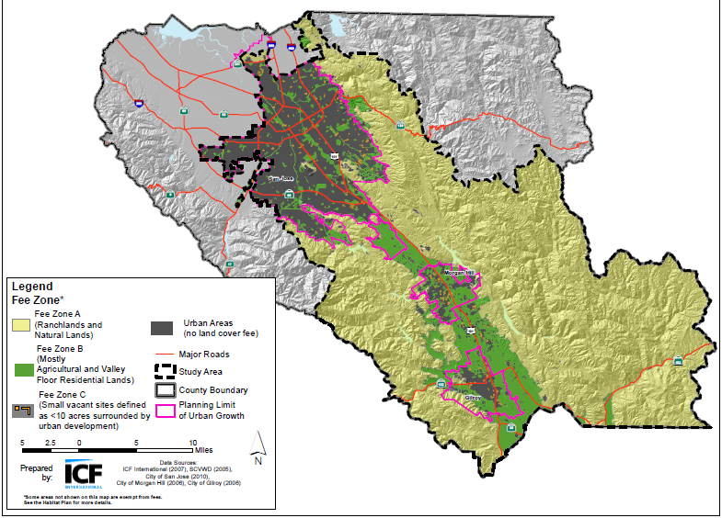
Habitat Plan Fees
Vehicle-trip or by New Single Family Residence
Nitrogen Deposition
Land Cover Fees
Zone A
Zone B
Zone C
Specialty Fees
Occupied Burrowing Owl habitat (mapped)
Serpentine
Wetlands
Notes:
Where is the project located?
What land cover will be impacted?
Will the project result in additional vehicle trips?

Slide 70
Defining Impacts and Fee Paying Areas
Public & Private Projects
Urban Areas & < 10 acres | Urban & > 10 acres Rural Areas
Entire Parcel | Development area Project Footprint + 50’ buffer or 10’ buffer
Other Factors –
Linear Public Projects (Urban & Rural) – Footprint Only
Areas of site already developed – no land cover fees
Temporary Impacts

Slide 71
Specialty Fees
Fee Type |  | Urban Areas & < 10 acres | Urban & > 10 acres, Rural Areas
Occupied Burrowing Owl habitat | Mapped Breeding Owl Habitat per Geobrowser | Area w/in Parcel | Area within Development Area
Serpentine | Field Verified | Area w/in Parcel | Area within Development Area
Wetland | Field Verified | Area w/in Parcel | Area within Development Area
Notes:
Permanent
Temporary

Slide 72
Nitrogen Deposition Fee
Net new vehicle trips
New single family residences

Slide 73
How to Calculate fees
Land Cover Fees
Zone A
Zone B
Zone C
Specialty Fees
Occupied Burrowing Owl habitat (mapped)
Serpentine
Wetlands
Vehicle-trip or by New Single Family Residence
Nitrogen Deposition
+
+
= total fees
Notes:
Permanent
Temporary

Slide 74
How to Calculate fees
Urban Areas & Parcels < 10 acres
Notes:
Permanent
Temporary

Slide 75
How to Calculate fees
Urban & Parcels > 10 acres or Rural Areas Areas
Notes:
Permanent
Temporary

Slide 76
Non-fee paying land cover types
Urban/Suburban
Landfill
Developed Agriculture
Reservoir

Slide 77
Mitigation Fees
Fee type | Fee rate
Land Cover Fees
Zone A | $17,028 per acre
Zone B | $11,806 per acre
Zone C | $4,313 per acre
Urban Areas | No fee
Specialty Fees
Burrowing owl | $51,568 per acre
Serpentine | $55,410 per acre
Riparian, wetland, ponds | $142,838 - $383,283 per acre
Stream | $601 per linear foot
Other fees
Nitrogen deposition fee | $39.80 per residence or $3.98 per new daily vehicle trip

Slide 78
What Next?

Slide 79
Overview of the Compliance Process
Determine if project is a covered activity
Step 1
Verify Land Cover on Project Site
-------------------
Determine Conditions and Calculate Fees
Step 2
Complete, Submit, and Finalize Application/Reporting Package
Step 3
Pay Fees and Construct Project
------------------------------
Comply with Conditions
Step 4

Slide 80
Complete, Submit, and Finalize
Application/Reporting Package
Public Projects
Private Projects
Complete Reporting Form
Private Applicants submit forms Planning / Building Departments.

Slide 81
Overview of the Compliance Process
Determine if project is a covered activity
Step 1
Verify Land Cover on Project Site
-------------------
Determine Conditions and Calculate Fees
Step 2
Complete, Submit, and Finalize Application/Reporting Package
Step 3
Pay Fees and Construct Project
------------------------------
Comply with Conditions
Step 4

Slide 82
Pay Fees, Construct Project, and Comply with Conditions
Public Projects
Private Projects
Pay fees directly to Habitat Agency
Private Applicants submit fees to Planning / Building Departments.
Fees must be paid before construction starts (grading / building permit issued)
Planning Dept’s pass through forms / fees to Habitat Agency

Slide 83
Take Coverage
Project receives - Determination of Consistency
Habitat Plan Package is deemed complete
Conditions of approval have been established and imposed
Required fees (if applicable) have been paid.

Slide 84
Part 5
Case Studies

Slide 85
Public Project
Case Study 1: Silicon Valley Advanced Water Purification Center

Slide 86
Silicon Valley Advanced Water Purification Center
Project Overview
Existing Site Conditions
Project Impacts
Temporary impacts for pipeline construction
Overlapping fee and impact buffers
Conditions on Covered Activities
Fee paying land cover types

Slide 87
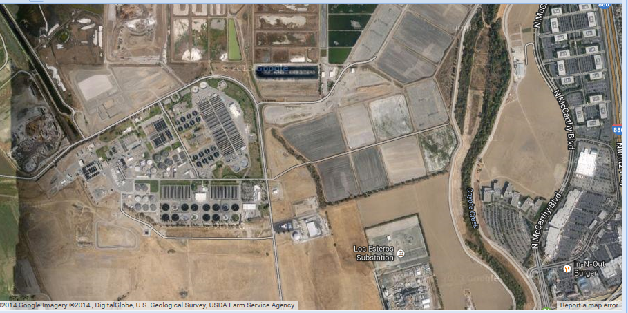
Case Study 1: Silicon Valley Advanced Water Purification Center
Project Overview
Existing Site Conditions
Project Impacts

Slide 88
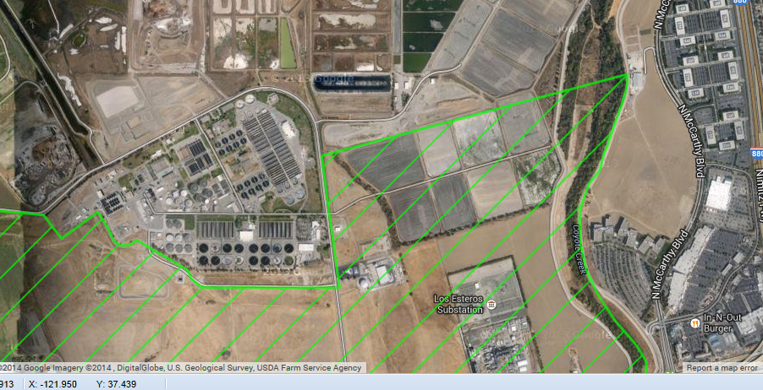
Case Study 1: Silicon Valley Advanced Water Purification Center

Slide 89
Habitat Plan Conditions
All Covered Projects
Covered Project Categories
Natural Communities
Condition 1
Condition 3
Urban Development
Condition 2
In-Stream Projects
Condition 4
In-Stream O&M
Condition 5
Rural Transportation Projects
Condition 6
Rural Development Projects
Condition 7
Rural O&M
Condition 8
Reserve System Implementation
Condition 9
Condition 10
Stream and Riparian
Condition 11
Wetland and Pond
Condition 12
Serpentine
Condition 13
Valley and Blue Oak
Condition 14
Wildlife
Bay Checkerspot Butterfly
Condition 13
Western Burrowing Owl
Condition 15
Least Bell’s Vireo
Condition 16
Tricolored Blackbird
Condition 17
San Joaquin kit fox
Condition 18
Plants
Plant Salvage
Condition 19
Plant Avoidance and Minimization
Condition 20

Slide 90
Case Study 1: Silicon Valley Advanced Water Purification Center
All Covered Projects
Natural Communities
Wildlife
Urban Development
Condition 2
Stream and Riparian
Condition 11
Western Burrowing Owl
Condition 15
Condition 1
Condition 3

Slide 91
Habitat Plan Fees
Location
Zone A
Zone B
Zone C
Occupied Burrowing Owl habitat (mapped)
Land cover
Serpentine
Willow Riparian Forest and Mixed Riparian
Central California Sycamore woodland
Freshwater marsh
Seasonal wetlands
Ponds
streams
Vehicle-trip
Nitrogen Deposition
Notes:
Where is the project located?
What land cover will be impacted?
Will the project result in additional vehicle trips?

Slide 92
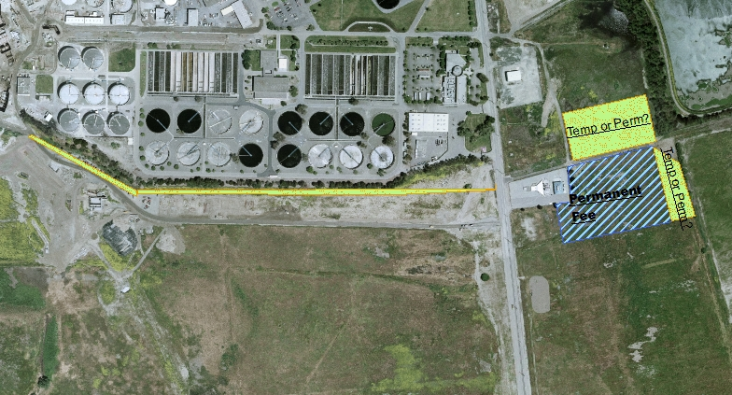
Case Study 1: Silicon Valley Advanced Water Purification Center
Location
Zone A
Occupied Burrowing Owl habitat (mapped)
Land cover
Willow Riparian Forest and Mixed Riparian
Vehicle-trip
Nitrogen Deposition

Slide 93
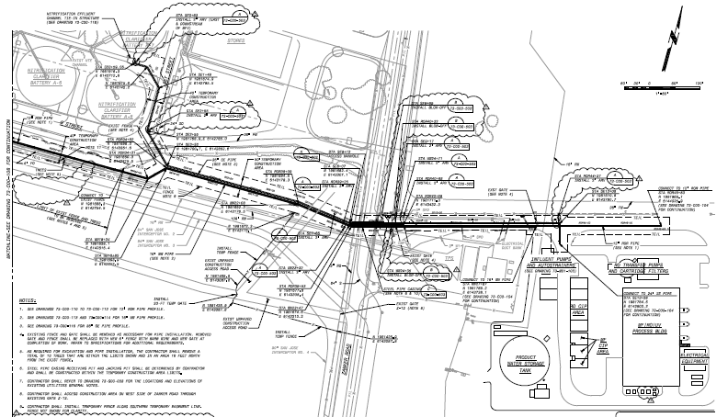
Case Study 1: Silicon Valley Advanced Water Purification Center
Developed
Natural
Non-Fee Paying Land Cover Types
Urban-Suburban
Developed Agriculture
Reservoir
Landfill
Linear Public Projects
No buffers for fees or impact calculations

Slide 94
Private Project
Case Study 2: Santa Clara County

Slide 95
Case Study 2: Private Project in Santa Clara County
Project Overview
Existing Site Conditions
Project Impacts
Conditions on Covered Activities
Fee paying land cover types

Slide 96
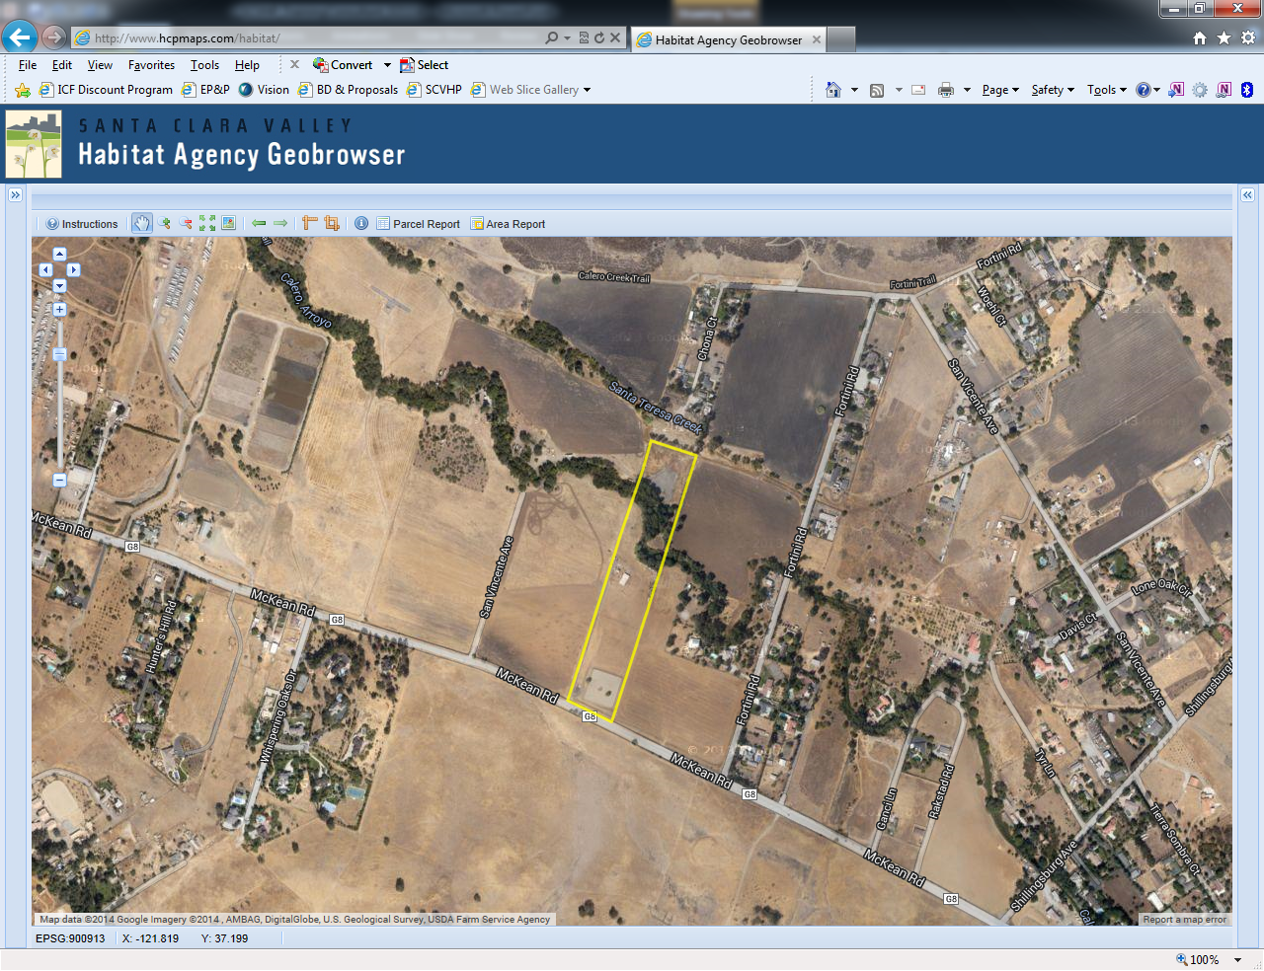
Case Study 2: Private Project in Santa Clara County

Slide 97
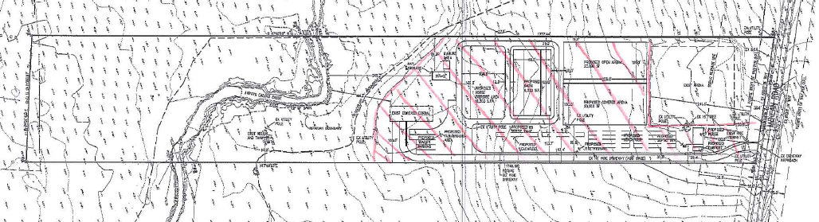
Project Overview
Existing Site Conditions
Project Impacts

Slide 98
Habitat Plan Conditions
All Covered Projects
Covered Project Categories
Natural Communities
Condition 1
Condition 3
Urban Development
Condition 2
In-Stream Projects
Condition 4
In-Stream O&M
Condition 5
Rural Transportation Projects
Condition 6
Rural Development Projects
Condition 7
Rural O&M
Condition 8
Reserve System Implementation
Condition 9
Condition 10
Stream and Riparian
Condition 11
Wetland and Pond
Condition 12
Serpentine
Condition 13
Valley and Blue Oak
Condition 14
Wildlife
Bay Checkerspot Butterfly
Condition 13
Western Burrowing Owl
Condition 15
Least Bell’s Vireo
Condition 16
Tricolored Blackbird
Condition 17
San Joaquin kit fox
Condition 18
Plants
Plant Salvage
Condition 19
Plant Avoidance and Minimization
Condition 20

Slide 99
updated
All Covered Projects
Covered Project Categories
Wildlife
Natural Communities
Rural Development Projects
Condition 7
Stream and Riparian
Condition 11
Tricolored Blackbird
Condition 15
Condition 1
Condition 3

Slide 100
Habitat Plan Fees
Location
Zone A
Zone B
Zone C
Occupied Burrowing Owl habitat (mapped)
Land cover
Serpentine
Willow Riparian Forest and Mixed Riparian
Central California Sycamore woodland
Freshwater marsh
Seasonal wetlands
Ponds
streams
Vehicle-trip
Nitrogen Deposition
Notes:
Where is the project located?
What land cover will be impacted?
Will the project result in additional vehicle trips?

Slide 101
updated
Location
Zone B
New Residence
Nitrogen Deposition

Slide 102
Questions?

Slide 103
Thank you

